Slide 1


“When I Heard the Learn’d Astronomer”
Unit 3 Lesson 3

Slide 2
“When I Heard the Learn’d Astronomer”
I WONDER… | I LEARNED…

Slide 3

Standards & Objectives
5.RL.KID.1 Quote accurately from a text when explaining what the text says explicitly and when drawing inferences from the text.
5.RL.KID.2 Determine a theme or central idea of a story, drama, or poem and explain how it is conveyed through details in the text; summarize the text.
Identify the poetic device anaphora.
Explain how anaphora's use affects a poem’s meaning.
Use textual evidence to discuss a poem.

Slide 4

Read to determine how figurative language and literary devices enhance a poem.
THE BIG QUESTION:
What are some important qualities of a poem?
Notes:
• Tell students that this lesson includes a poem about the difference between a description of, or lesson about, a thing versus the thing itself.
• Tell students that before they read the poem they will think about different ways to describe something.

Slide 5

Notes:
• Ask students to raise a hand if they would want to put the chemicals shown in the projection into their bodies.
• Ask students to raise a hand if they would not want to put the chemicals shown in the projection into their bodies.

Slide 6

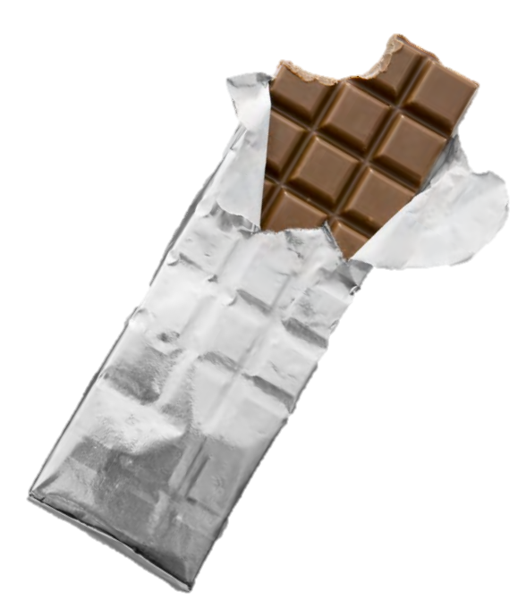
Notes:
• Ask students to raise a hand if they would like to eat the item shown in Projection 2.
• Explain to students that Projection 1 shows the chemicals that make up/ describe the contents of chocolate whereas Projection 2 shows the thing itself, chocolate. Both projections actually refer to the same thing, but they do so in different ways.
• If you are not distributing chocolate to the students, ask them which they would prefer: eating chocolate, looking at a picture of chocolate, or looking at a list of the chemicals that make up chocolate.

Slide 7

Whitman Video 1
What things did you see in the video?
Based on the images in the video, what do you think is the topic of the poem?

Slide 8
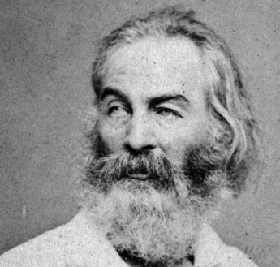
Born on May 3, 1819 in Long Island, New York, Walt Whitman worked as a teacher and a journalist before becoming a poet. His poetry related to people of all backgrounds and made him one of America’s most well-known and beloved writers.
During Whitman’s time, the United States of America was divided by slavery, which threatened to split the country in two. The Civil War inspired him to write Drum Taps, a collection of poetry about the war and his experiences as a battlefield nurse. His writing was powerful; even President Lincoln admired him. In fact, several of his poems are tributes to Lincoln.
Whitman also wrote poems about nature. Whitman died in 1892; however, his poetry and free verse style, along with his conversational tone, remain appreciated and admired.

Slide 9

Words to Know
astronomer, n. scientist who studies outer space and its bodies (such as stars, moons, and planets)
figures, n. numbers or diagrams
learn’d, adj. a shortened version of learned (in which the apostrophe stands in for missing letter e) used to describe people, especially those who have spent many years studying one subject
lecture, n. a talk, usually given by a teacher or other expert, on a single topic
mystical, adj. not of this world
proofs, n. in math, arguments that show an idea or rule must be correct
unaccountable, adj. something that cannot be explained; can be used to refer to a person who does not take responsibility

Slide 10
Literary Vocabulary
anaphora, n. the repetition of words (or phrases) at the start of a series of lines in a poem

Slide 11
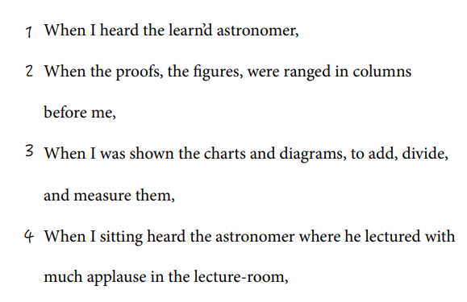
“When I Heard the Learn’d Astronomer”
(lines 1 – 4)
Line 1 describes how the speaker interacted with the “learn’d astronomer.” Remember that apostrophes (’) may be used to show when letters are missing from a word. Look at the word learn’d. Think about other words that look like this one. What letter do you think might be missing?
Notes:
The missing letter is e; students may infer this from their knowledge of the word learned or from the fact that –ed is a common ending for words. Tell them that the word learned can be a verb (as in, “Today I learned things at school”) or an adjective (“She was a learned woman”). In this poem it is an adjective, because it describes the astronomer.

Slide 12
“When I Heard the Learn’d Astronomer”
(lines 1 – 4)
What is taking place between the speaker and the astronomer?
The following line describes the scene more completely: When I sitting heard the astronomer where he lectured with much applause in the lecture-room,
What words appear in this line that did not appear in the poem’s first line?
Notes:
The astronomer is speaking in a lecture room. The speaker of the poem hears the astronomer, as stated in the title.
The new words are “sitting,” “where he lectured with much applause in the lecture room.”

Slide 13
“When I Heard the Learn’d Astronomer”
(lines 1 – 4)
When I sitting heard the astronomer where he lectured with much applause in the lecture-room,
What word appears in the first line of the poem that is left out here?
The speaker gets “much applause” for his lecture. Based on those words, how do most listeners probably feel about the speaker’s lecture?
Notes:
4. The missing word is “learn’d.”
• Tell students that they should think about why the speaker leaves that word out as they pair up and act out the roles of the speaker and the astronomer.
• Remind them that the poem says the astronomer “lectured.” Based on what the poem’s speaker is doing, students should act out what they think the scene looks like. They may consult the poem while they consider how to act out the scene.
5. Answers will vary, but students should infer that the people in the audience likely feel positively toward or appreciative of the lecture, as applause is generally given for things viewed favorably.

Slide 14
“When I Heard the Learn’d Astronomer”
(lines 1 – 4)
Look back at the beginning of the poem. The speaker hears the astronomer, but he sees many other things. Name what he sees in lines 2 and 3.
Whitman repeats the word when here a great deal. Where does when appear in these lines?
There is a purpose in using anaphora. What does the speaker here seem to be stressing by repeating the word when?
Notes:
6. He sees proofs, figures, charts, columns, and diagrams.
7. When appears at the start of each line.
Tell students that when a word or phrase is repeated at the start of several lines of a poem, it’s called anaphora. Poets often use the poetic device anaphora to add emphasis to a thought, idea, or emotion.
8. Answers will vary, but the idea is that the students are thinking about the poem’s content and form and using material from the poem to help substantiate their ideas. Examples include that he is stressing that he heard and saw a lot of different things, and that by repeating the same word, he is stressing that everything in the lecture seemed the same to him.
• At this point, summarize the factual material of the first four lines for students: The speaker is remembering when he attended an astronomy lecture and was bombarded with a lot of information. He is also repeating certain words. It’s important to note that this is what the speaker tells us about his experience.
• Tell them that even though the speaker does not say exactly what he feels, we can use the poem’s clues to consider how the speaker might feel in this situation.
• Tell students that this reminds you of the video, and that you’d like them to watch the video again as they listen to the first four lines of the poem.

Slide 15
Whitman Video 2
How do the images show what the speaker describes?
Based on the images in the video and the anaphora in these lines, how do you think the speaker might feel about the lecture? Use details from the poem or video to explain why you think he feels this way.
Notes:
Answers will vary, but the goal is for students to link the images and the words. They may identify the hand as the astronomer’s, or they may recognize that the images filling the screen are the astronomer’s proofs and figures.
Answers will vary, but the idea is that students are looking to the poem to substantiate their reasoning. Students will likely understand that the speaker is bored or unhappy; they may link this to the anaphora or to the fact that they do not have time to read all the figures in the video; the speaker is overwhelmed.
Tell students you will look together at the whole poem to see how the speaker feels about the lecture and see if they have predicted his feelings correctly.

Slide 16
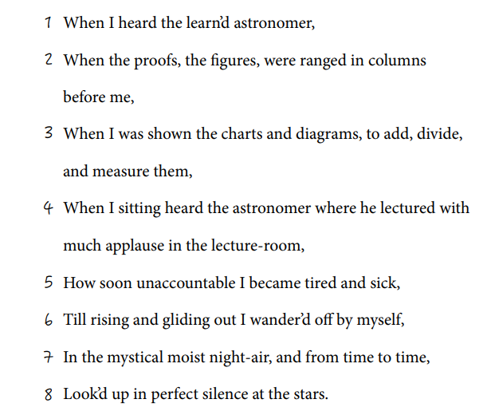
“When I Heard the Learn’d Astronomer”
By Walt Whitman
Notes:
Note: When poets write in extremely long lines of verse, as Whitman often does in “When I Heard the Learn’d Astronomer,” the lines will not always fit onto the page. The overflow text is indented, but the line number remains the same. Because this convention can appear confusing, the Poet’s Journal includes a version of the poem with line numbers. Explain this numbering system to students when they first read the entire poem, as they will need to understand the numbering system in order to correctly identify the lines referred to by the questions.

Slide 17
Standards & Objectives
5.W.TTP.3 Write narratives to develop real or imagined experiences or events using an effective technique, such as descriptive details and clear event sequences.
  c. Use narrative techniques, such as dialogue, pacing, and description to develop experiences and events or show the responses of characters to situations.
Compose a personal poem using the poetic device anaphora.

Slide 18
Compose your own personal poem
Pick a time in your past when something made you feel bored and, then, a change happened that made things more interesting. Maybe it was waiting at the doctor’s office until you could get the ice cream your parents promised you afterward, or maybe it was when you had to clean your room before you could play with your friends.
Make sure to think of a time when you remember feeling bored, but when you also stopped feeling bored as soon as something you liked happened.
Describe the place or situation by answering the following questions:
    1. Where were you?
    2. What were the people around you doing?
    3. What did you hear, see, taste, touch, or smell?
    4. How long did it feel like you were there?

Slide 19
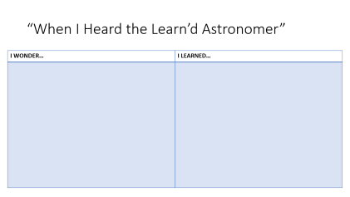
EXIT SLIP
REFLECTION
Imagine your friend had trouble understanding anaphora. Help them understand by describing anaphora in your own words, including an example.

