Slide 1

“Isla”
Unit 3 Lesson 11

Slide 2
“Isla”
I WONDER…. | I LEARNED…

Slide 3
Standards & Objectives
5.RL.KID.1 Quote accurately from a text when explaining what the text says explicitly and when drawing inferences from the text.
5.RL.KID.3 Compare and contrast two or more characters, settings, or events in a story or drama, drawing on specific details in a text.
Use textual evidence to compare and contrast characters’s reactions in a poem.

Slide 4
Read to determine how figurative language and literary devices enhance a poem.
What skills or traits does someone need to write poetry?

Slide 5
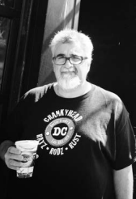
Virgil Suárez was born in Havana, Cuba, in 1962. His family moved several times, and when he was an adolescent, they immigrated to the United States. In his new home Suárez sought to find acceptance by learning to share his voice. He was influenced by the music, culture, and stories of his friends and family. As a professor today, Suárez teaches his students “to listen to the voices in their lives, the present, the past, whatever speaks to them,” as a source of inspiration in their writing.
As both a poet and a novelist, Suárez focuses on the experience of migrant peoples seeking to find a home in a new culture. His works Latin Jazz, Garabato Poems, Spared Angola: Memories of Cuban-American Childhood, and many others highlight the themes of identity, culture, and language. Virgil Suárez continues to write novels and poetry and lives in Florida.
Notes:
Introduce the Poem
Tell students that the poem in this lesson is about a boy who feels isolated or alone after moving to a new country where he does not yet speak the language.
Explain that Virgil Suárez, the poet, was born in Cuba, so his first language was Spanish. In this poem he uses several Spanish words to help lend detail to the scene he describes. Direct students to the note with translations for these words and review them prior to reading the poem.
As they listen to and read the poem, students should pay attention and try to notice what the speaker connects with in his new country.

Slide 6
Challenging Words
exiled, adj., away from one’s homeland
transfixed, adj., intensely focused

Slide 7
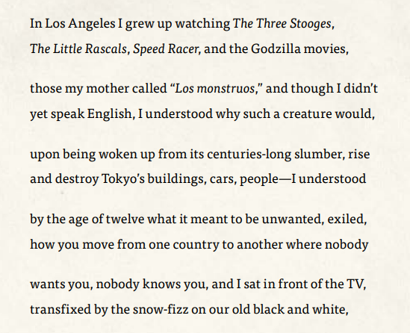
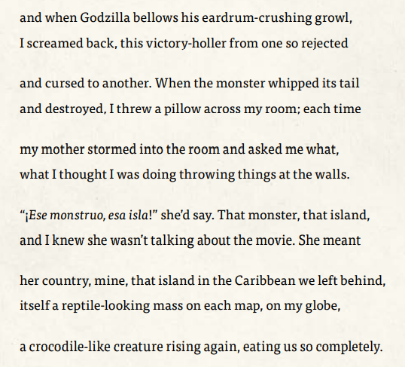

Slide 8
Discussion and Comprehension
Where is the speaker?
What does the poem tell us about the speaker’s home country?
What television shows and movies does the speaker like to watch?
According to the poem, why does the speaker feel isolated in his new country?
What does the speaker of the poem do to express his emotions?
Notes:
He is in Los Angeles.
It is an island in the Caribbean.
He likes to watch The Three Stooges, The Little Rascals, Speed Racer, and the Godzilla movies.
Nobody wants him; nobody knows him; he does not yet speak English.
You may wish to allow students to share what they know of the Godzilla movies; they may not realize that though there have been more recent films featuring Godzilla, Suárez is referring to the original Japanese films from the 1950s and ‘60s. In some of these films Godzilla even helps humans by protecting them from other giant monsters. If possible, show an image or movie clip of the iconic figure.
Explain that writing about difficult things is one way some people deal with them. Some writers also look to writing as a way to express or explore the many different emotions people may feel.
He throws a pillow and screams.

Slide 9
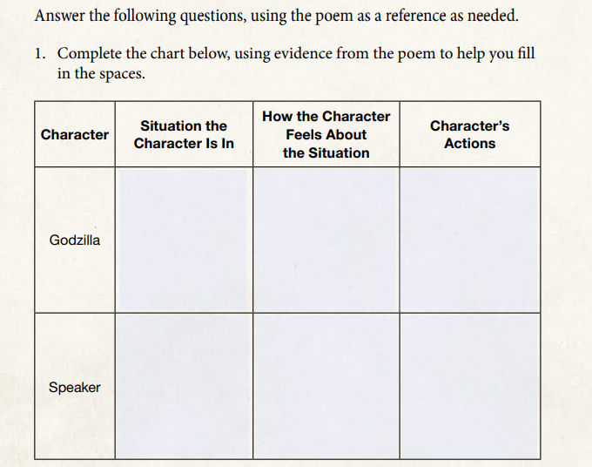
Destroyed buildings,
cars, people; growled,
bellowed, whipped
its tail
Woken up after centuries of sleep
Rejected, cursed
Moved to a
new country
Unwanted, exiled,
rejected, cursed
Screamed, threw
a pillow

Slide 10
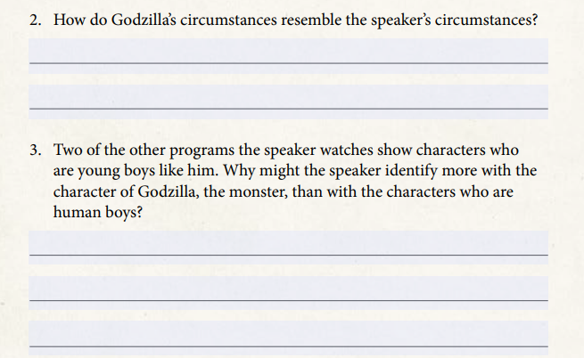
Both Godzilla and the speaker are unlike the creatures around them. They both are unwanted.
Because he does not fit in, the speaker feels like a monster rather than like a boy.
Notes:
Allow student volunteers to share answers to questions 1–3. Make sure students understand this material before asking students to complete questions 4–7.
Allow students to volunteer their answers to questions 4–7. Allow time if needed for discussion to make sure students see the difference between the speaker’s feelings and the mother’s reaction.

Slide 11
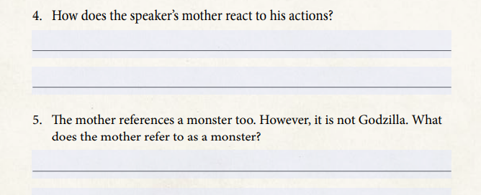
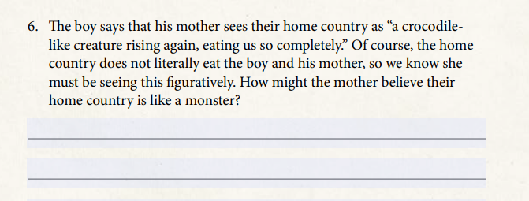
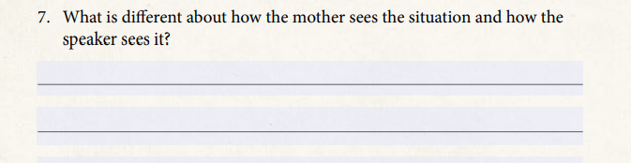
She storms into the room and asks why he throws things at the walls.
She calls their home country the monster.
The mother blames the home country for their current isolation and for the problems in their lives.
The boy blames himself. The mother blames their origins.

Slide 12
Check for Understanding: Thumbs-Up, Thumbs-Down
The characters in the poem see things similarly.
The character feels isolated, which means he feels surrounded by people.
The speaker does not feel like he “fits in”, which is why he compares himself to Godzilla.

Slide 13
Standards & Objectives
5.W.TTP.3 Write narratives to develop real or imagined experiences or events using an effective technique, such as descriptive details and clear event sequences.
  c. Use narrative techniques, such as dialogue, pacing, and description to develop experiences and events or show the responses of characters to situations.
5.W.RBPK.9 Draw evidence from literary or informational texts to support analysis, reflection, and research, applying grade 5 standards for reading.
  Compose an original poem in which two characters respond differently to the same circumstance.

Slide 14
Compose a poem that shows how two different characters feel about the same thing.
EXAMPLES:
A messy room: how students see it versus how parents see it
Homework: how teachers see it versus how students see it
A favorite song, book, or movie: how you see it versus how your siblings see it
Notes:
Tell students that in this writing exercise, they will compose poems that show how two different characters feel about the same thing.
Allow students to work in small groups to list other things that people view in different ways, then ask each group to share some of its suggestions with the class.
Tell students to each pick the thing they want to write about in their poem.

Slide 15
Write your poem
Name the situation or object your characters will react to in the poem.
Name the two characters who will be reacting.
Describe character 1’s reaction.
What details about character 1 help shape his or her reaction?
What details about character 2 help shape his or her reaction?

Slide 16


REFLECTION
EXIT SLIP
Think about the differences between the speaker’s point of view and the mother’s perspective. How might this poem change if it were told from the mother’s perspective? In what ways might it stay the same?

