Slide 1

Lesson 21
-s /z/

Slide 2
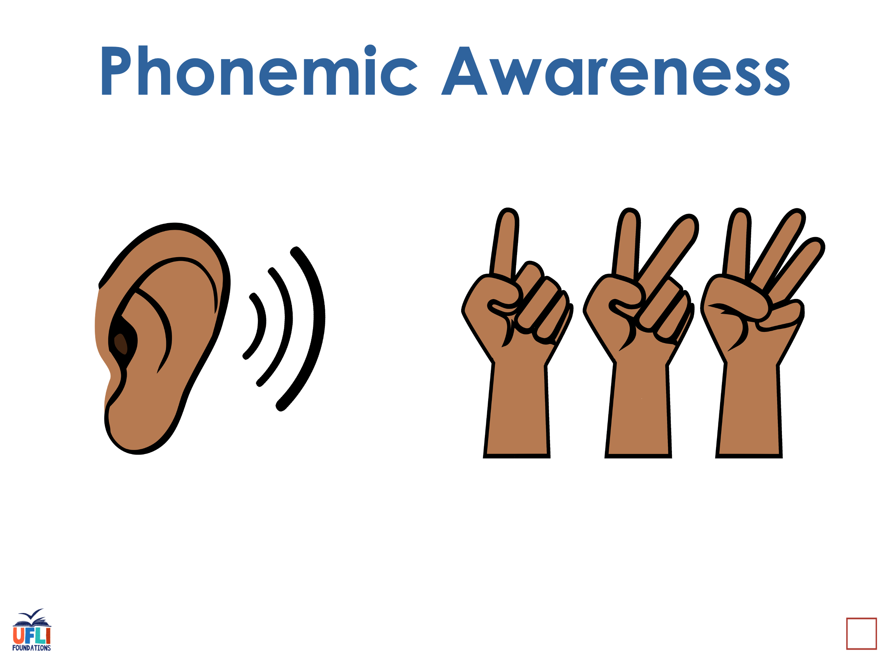
Notes:
See UFLI Foundations lesson plan Step 1 for phonemic awareness activity.

Slide 3
I’m going to give you some sounds, tell me what word it is….
Notes:
See UFLI Foundations lesson plan Step 1 for phonemic awareness activity.

Slide 4
I’m going to tell you a word and I want you to finger stretch it for me…
Notes:
See UFLI Foundations lesson plan Step 1 for phonemic awareness activity.

Slide 5
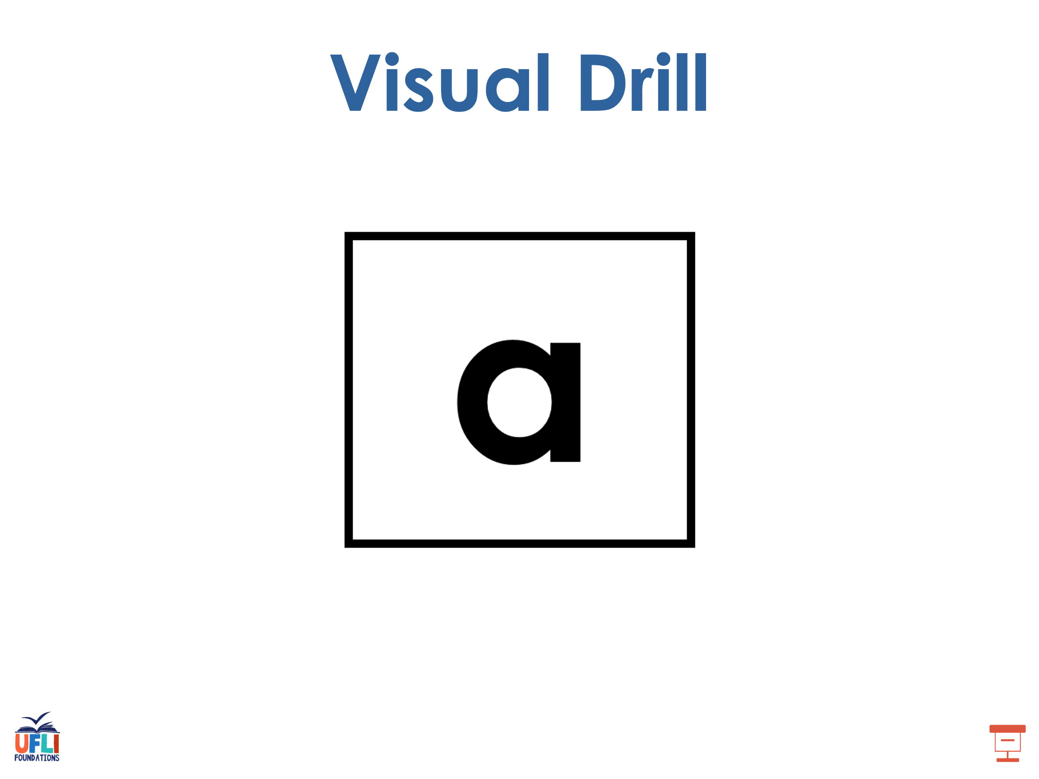
With each letter
I want you to tell me the
letter and the sound.
Notes:
See UFLI Foundations lesson plan Step 2 for student phoneme responses.

Slide 6
s

Slide 7
e

Slide 8
b

Slide 9
g

Slide 10
u

Slide 11
c

Slide 12
d

Slide 13
o

Slide 14
n

Slide 15
i

Slide 16
f

Slide 17
p

Slide 18
t

Slide 19
m

Slide 20
a

Slide 21
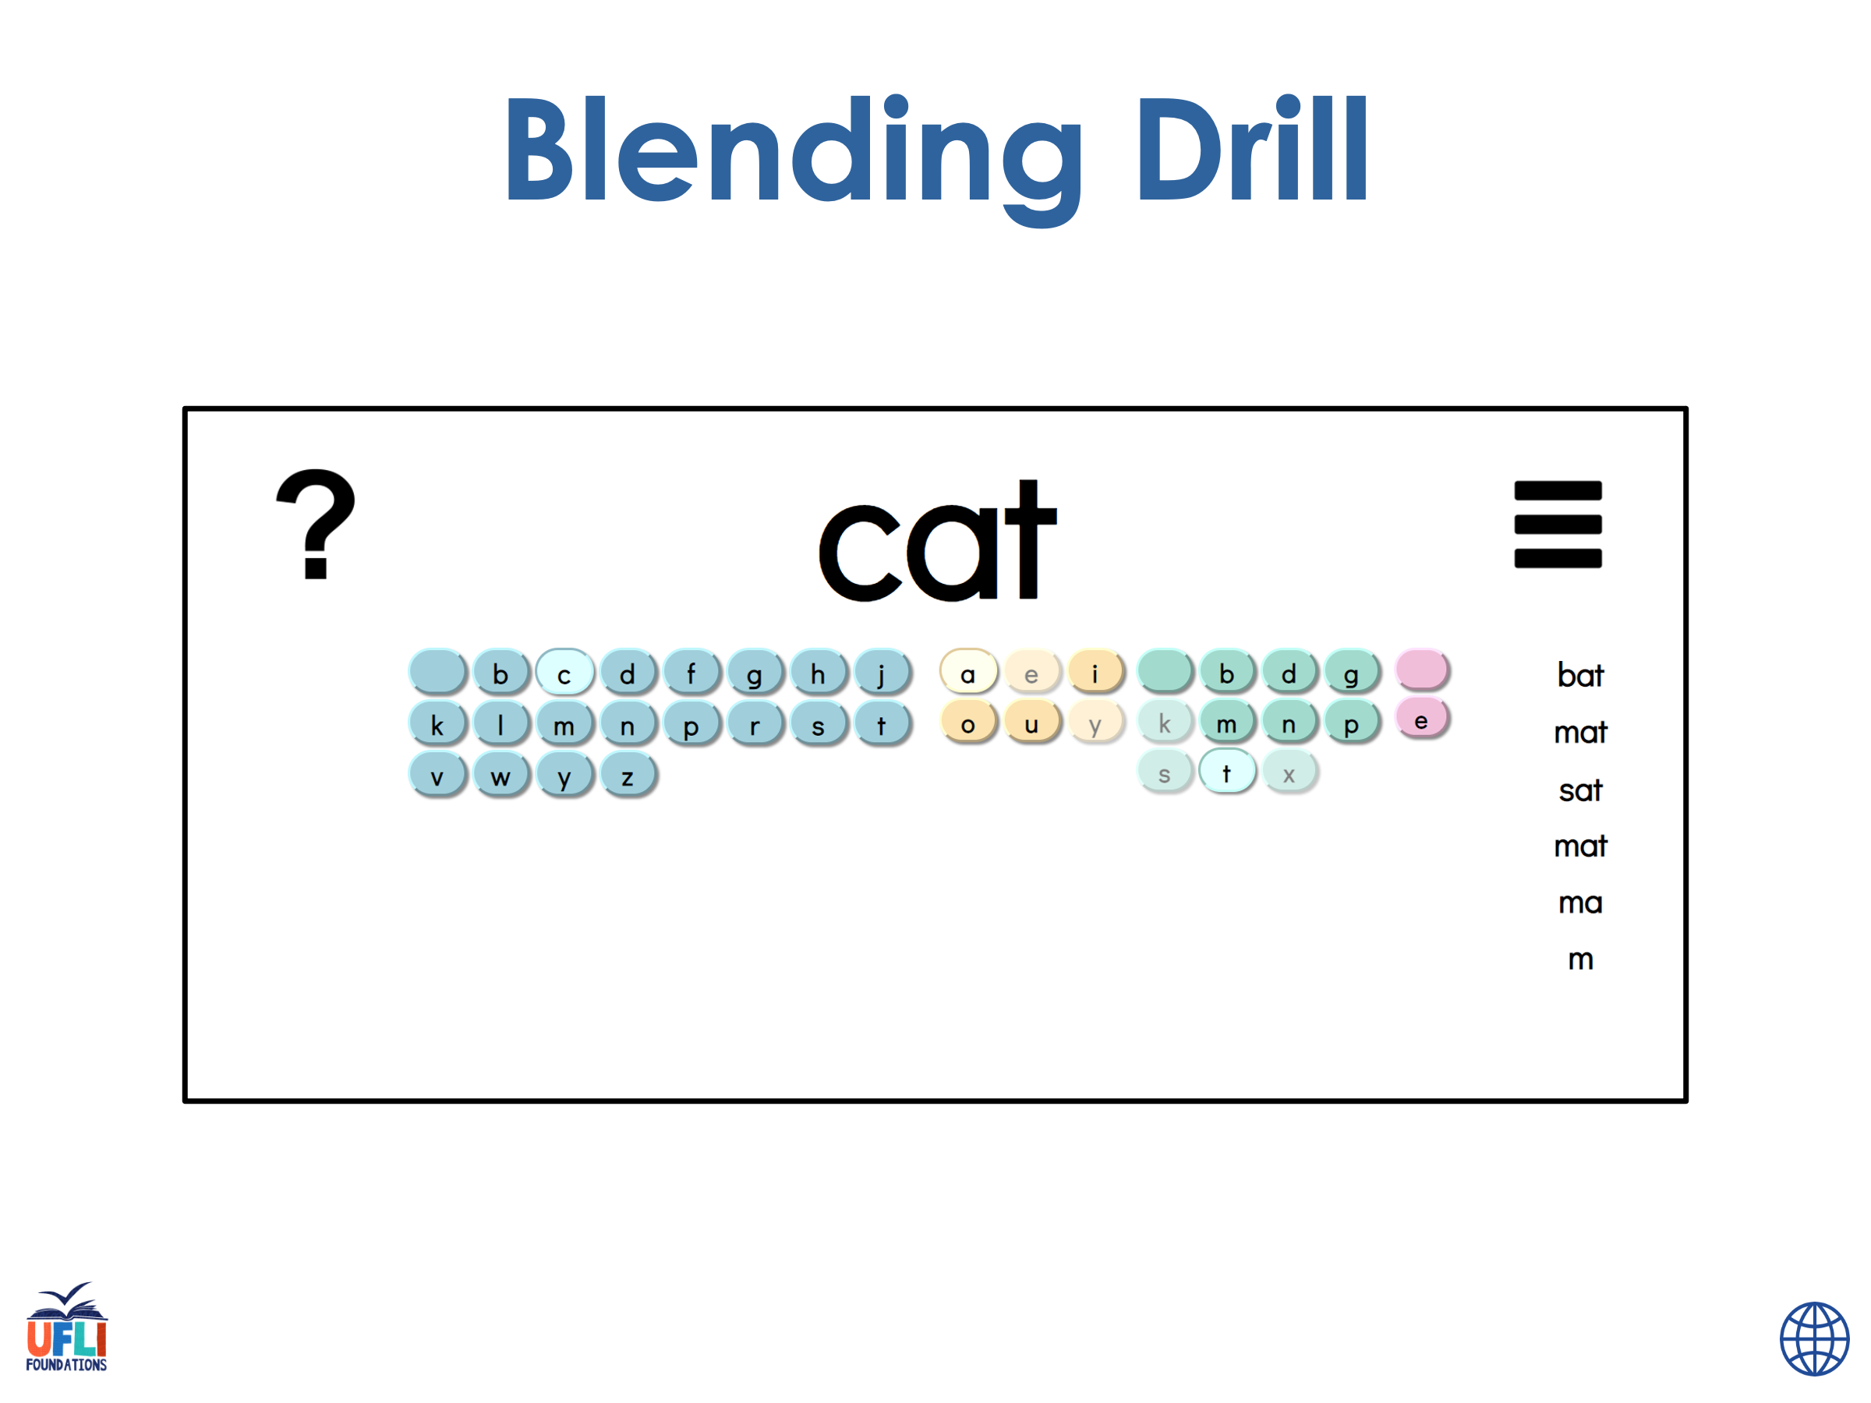
Get White Boards with Lines
I want you to write this word. Finger Stretch it to help you match the sounds and letters.
Now we are going to blend all the letters together to say the word.
(make write 3 times for extra practice)
Notes:
See UFLI Foundations lesson plan Step 4 for blending drill word chain and grid.
Visit ufliteracy.org to access the Blending Board app.

Slide 22
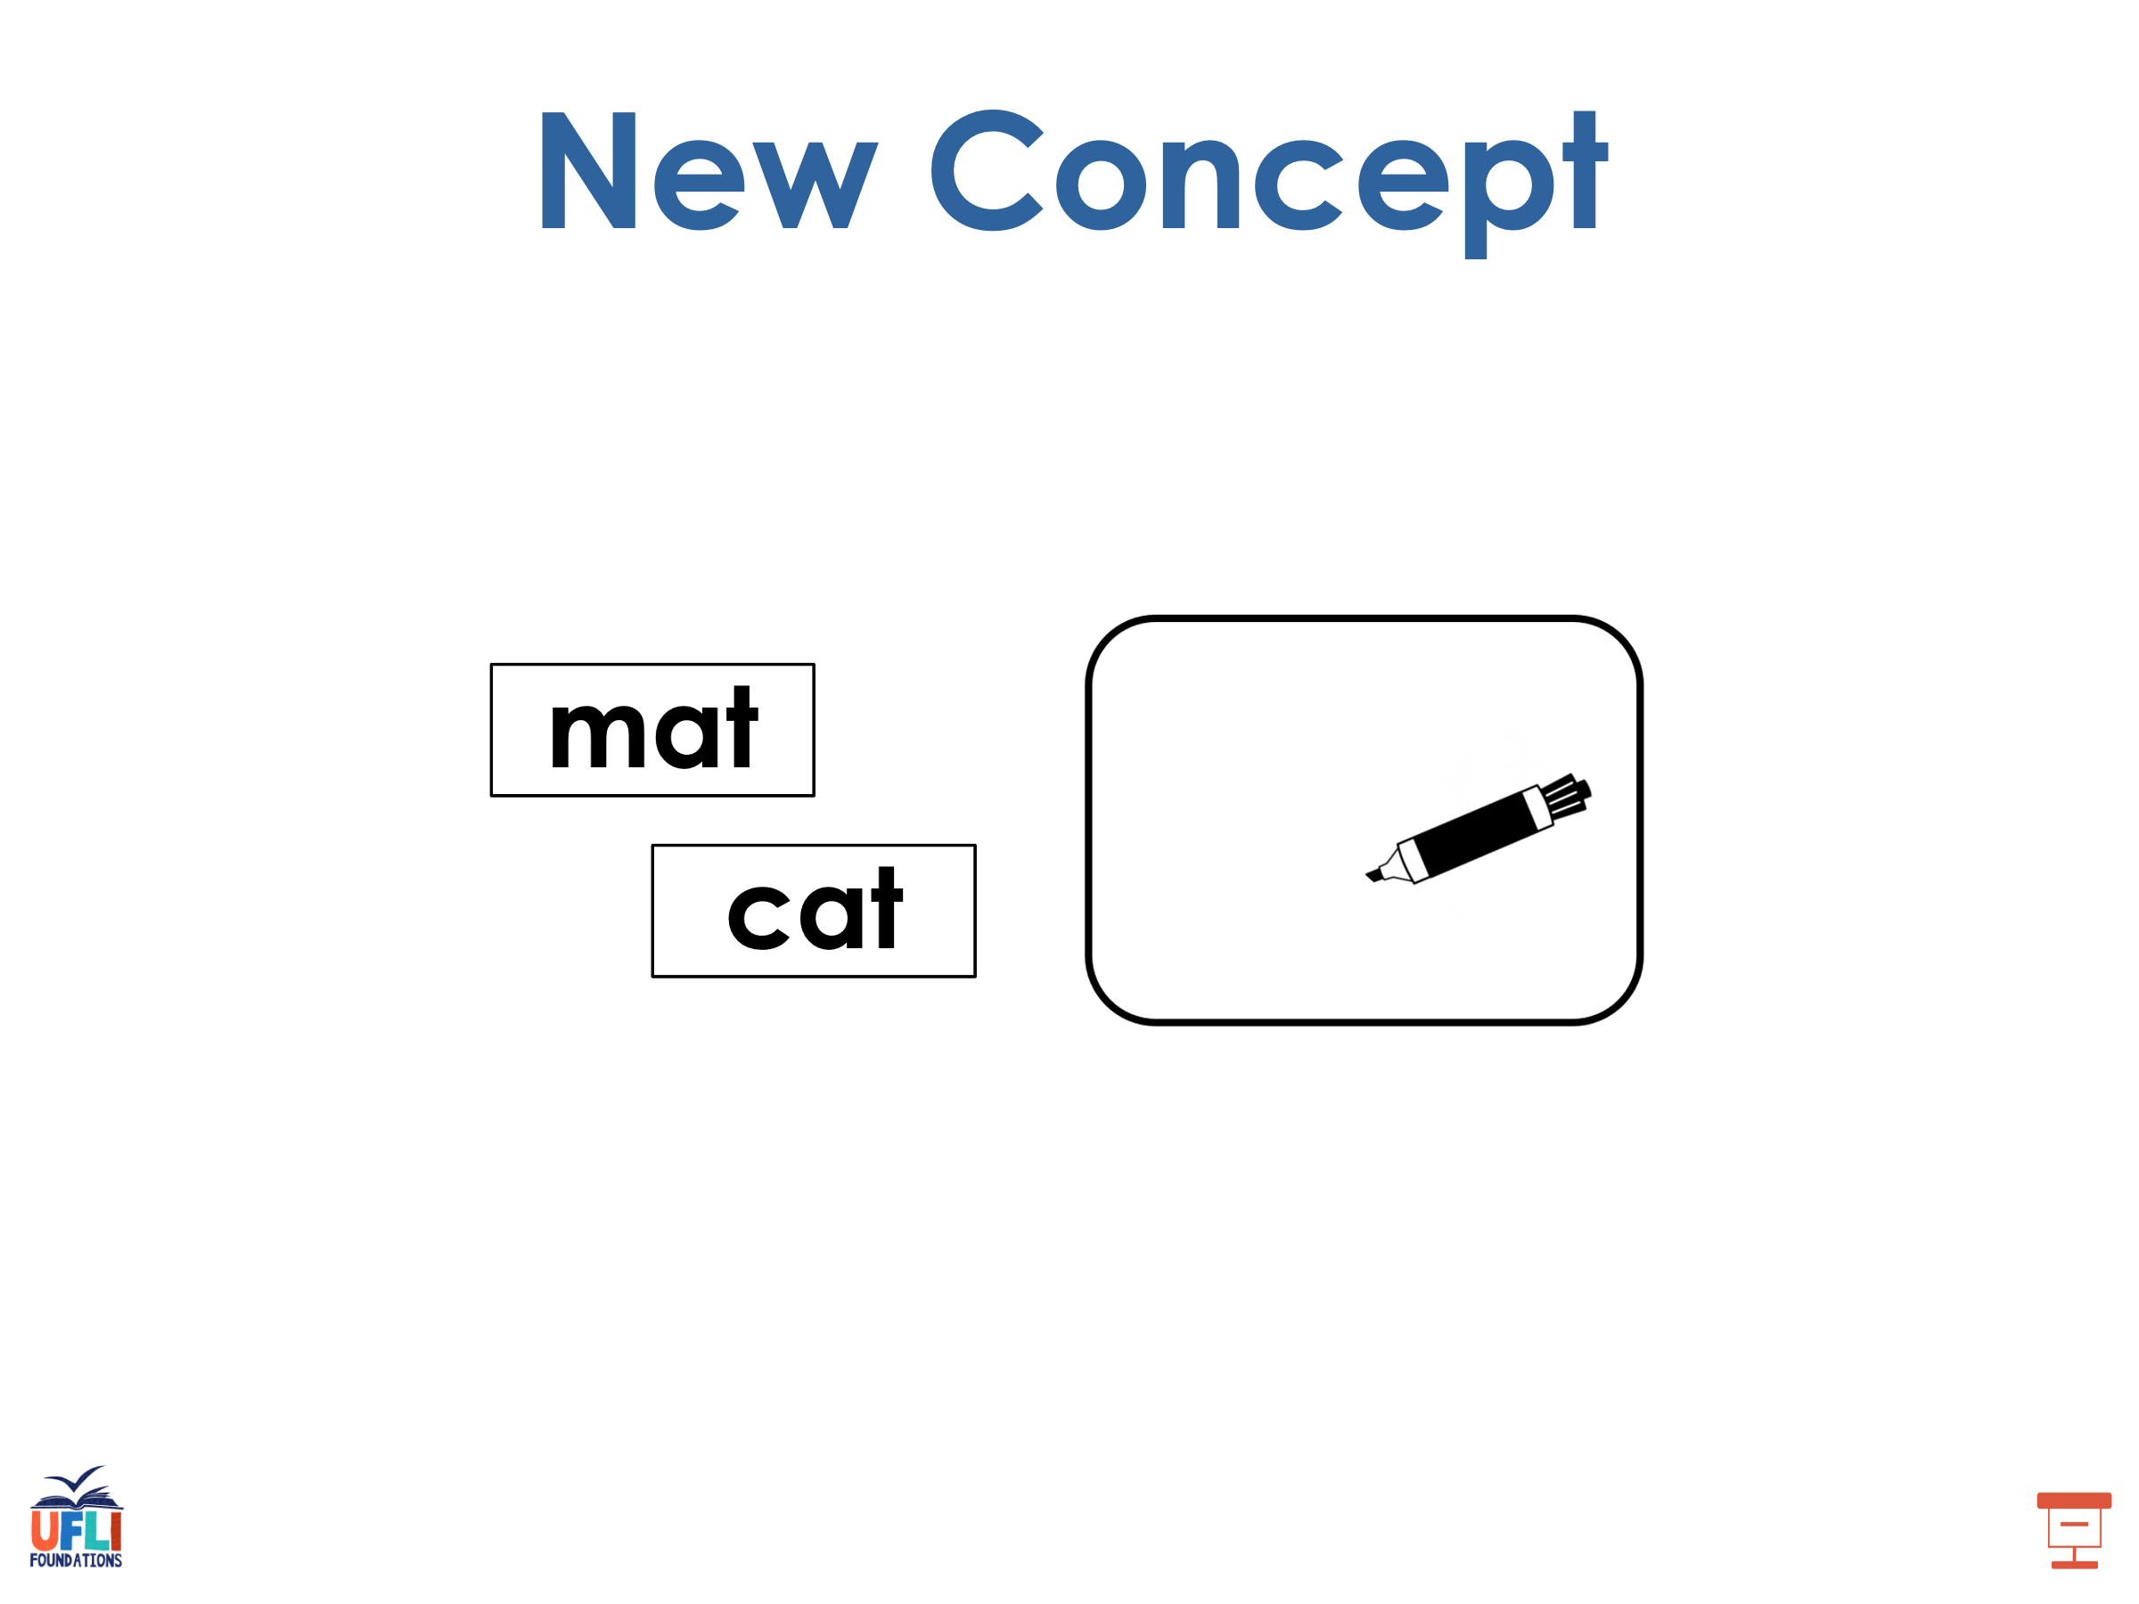
Ready to learn something new?
s
Notes:
See UFLI Foundations lesson plan Step 5 for recommended teacher language and activities to introduce the new concept.

Slide 23
fans
pods
Notes:
Say the words with the /z/ sound s

Slide 24

fans
pods

Slide 25
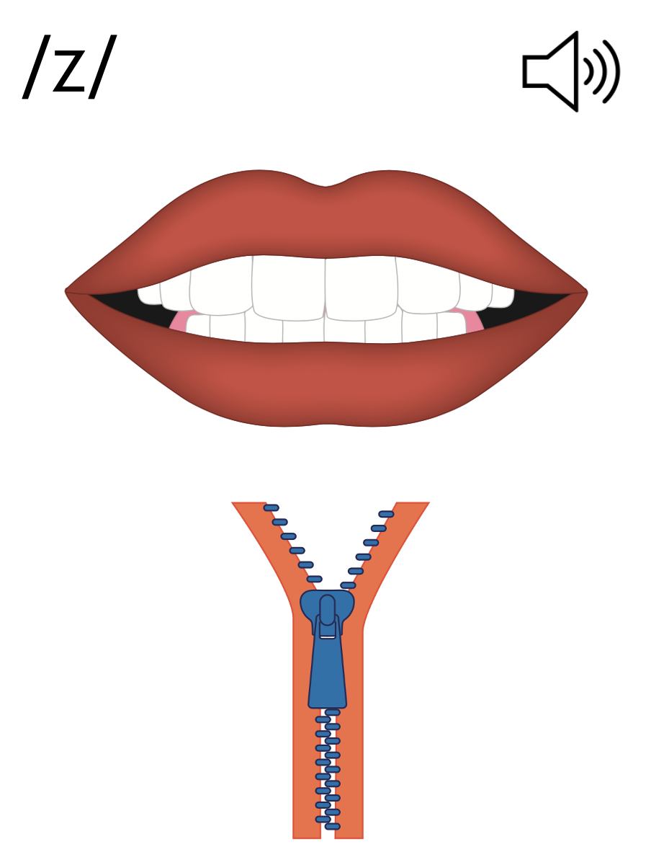
s

Slide 26
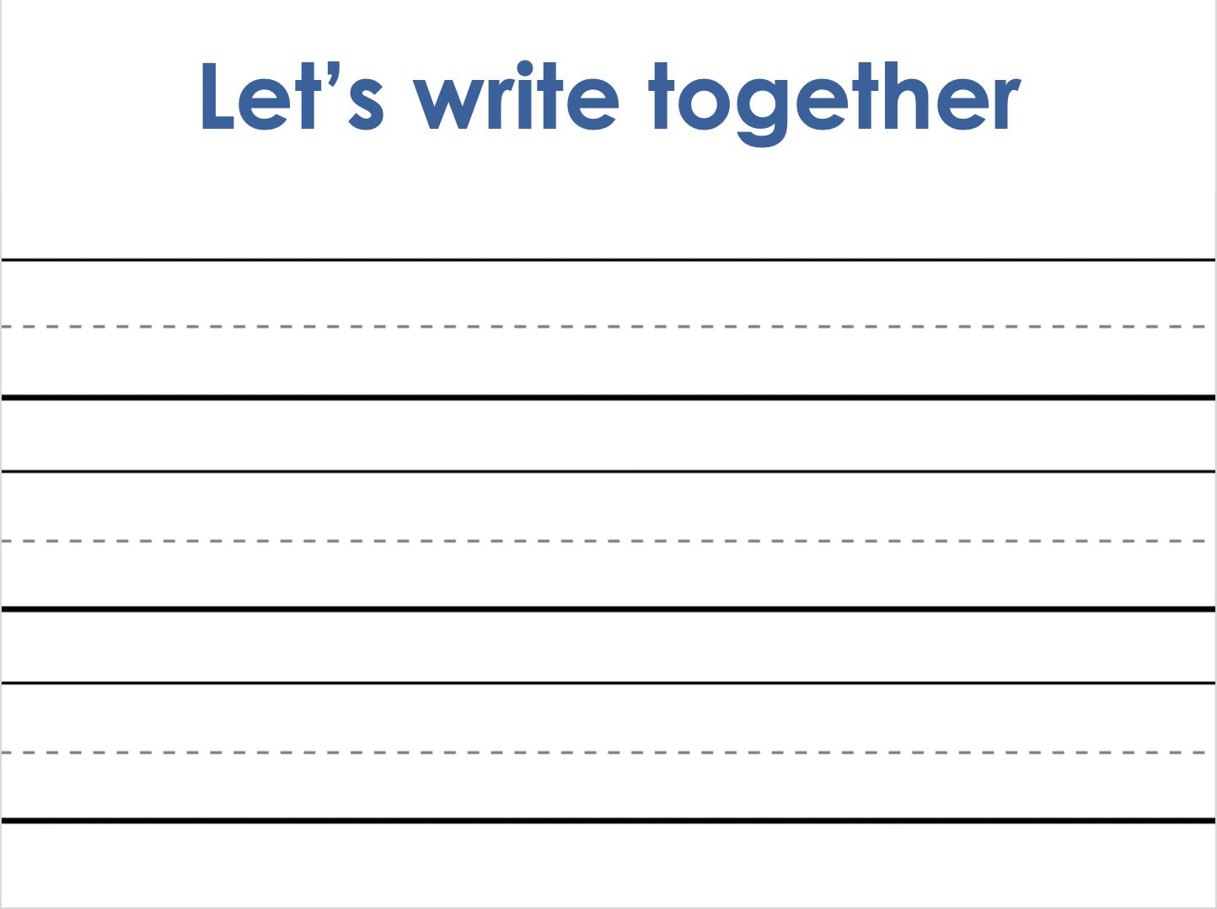
Let’s now write the s letter, and some s /z/ words
Notes:
Handwriting paper for letter formation practice. Use as needed.
See UFLI Foundations manual for more information about letter formation.

Slide 27
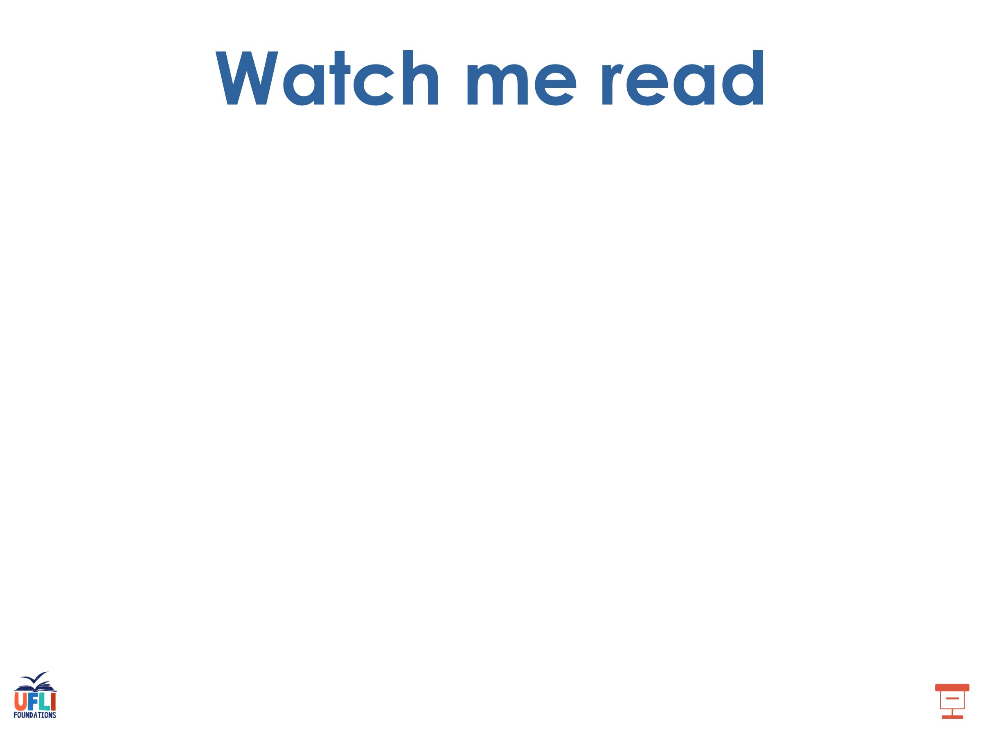
is
dads

Slide 28
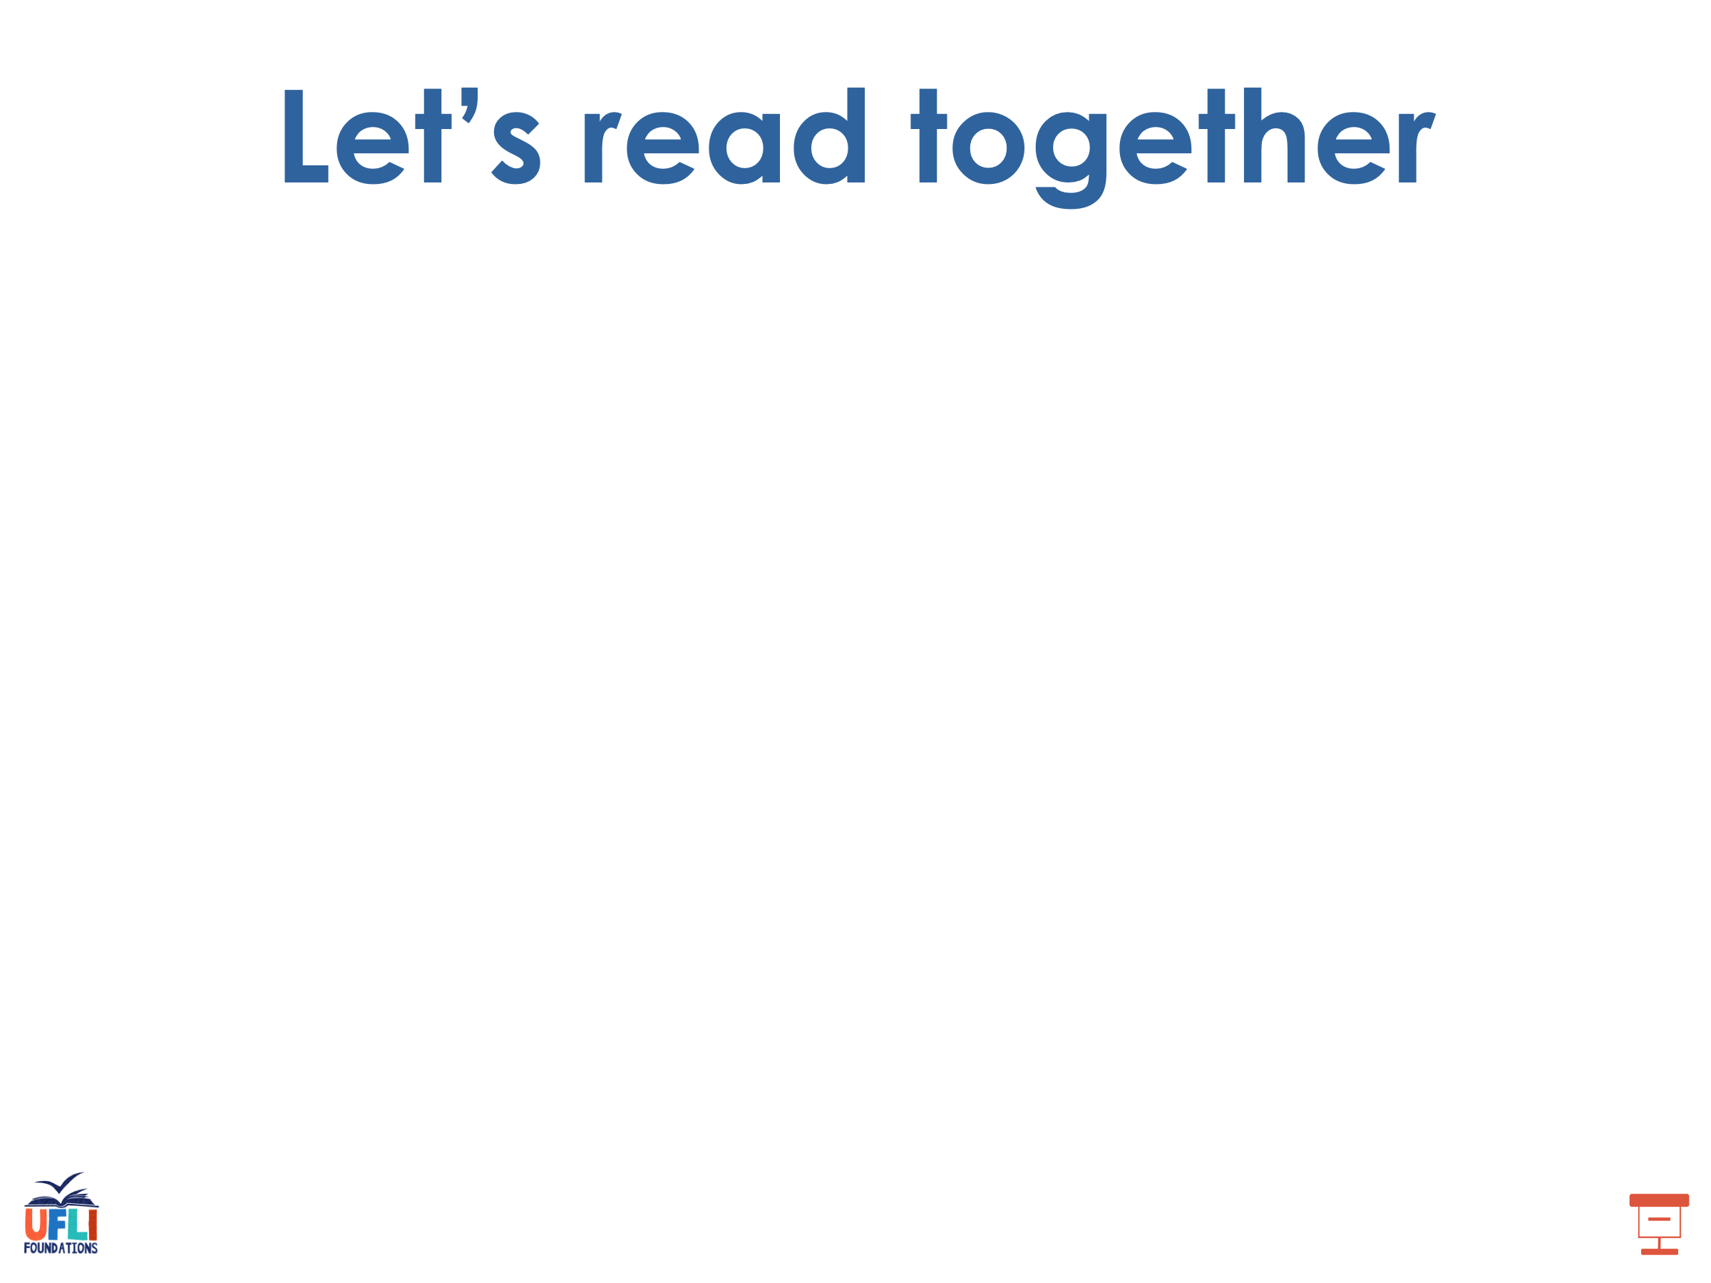
is
as
fans
bugs
bags
pans

Slide 29
fins
dogs
suds

Slide 30
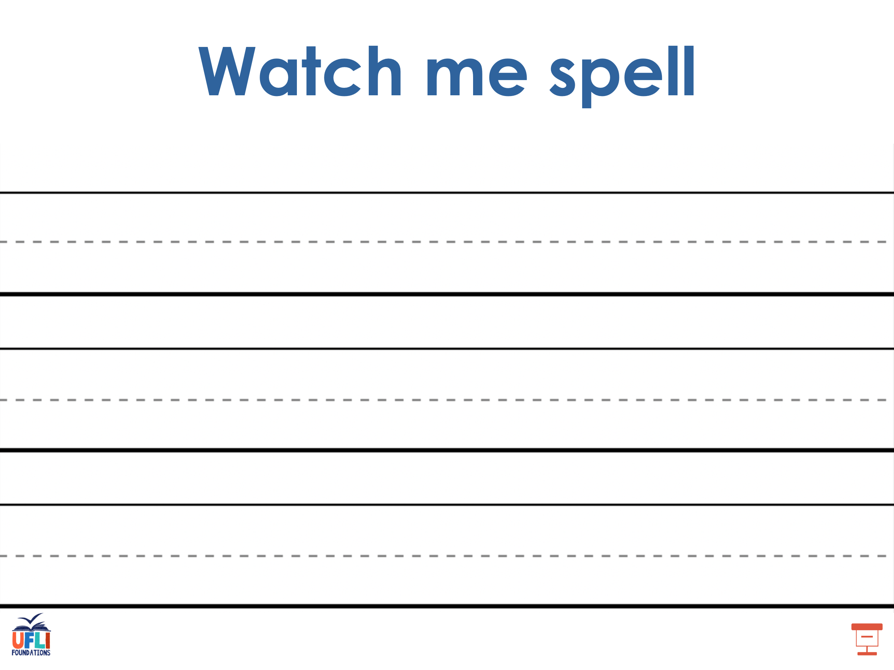
Notes:
See UFLI Foundations lesson plan Step 5 for words to spell.
Handwriting paper to model spelling.

Slide 31
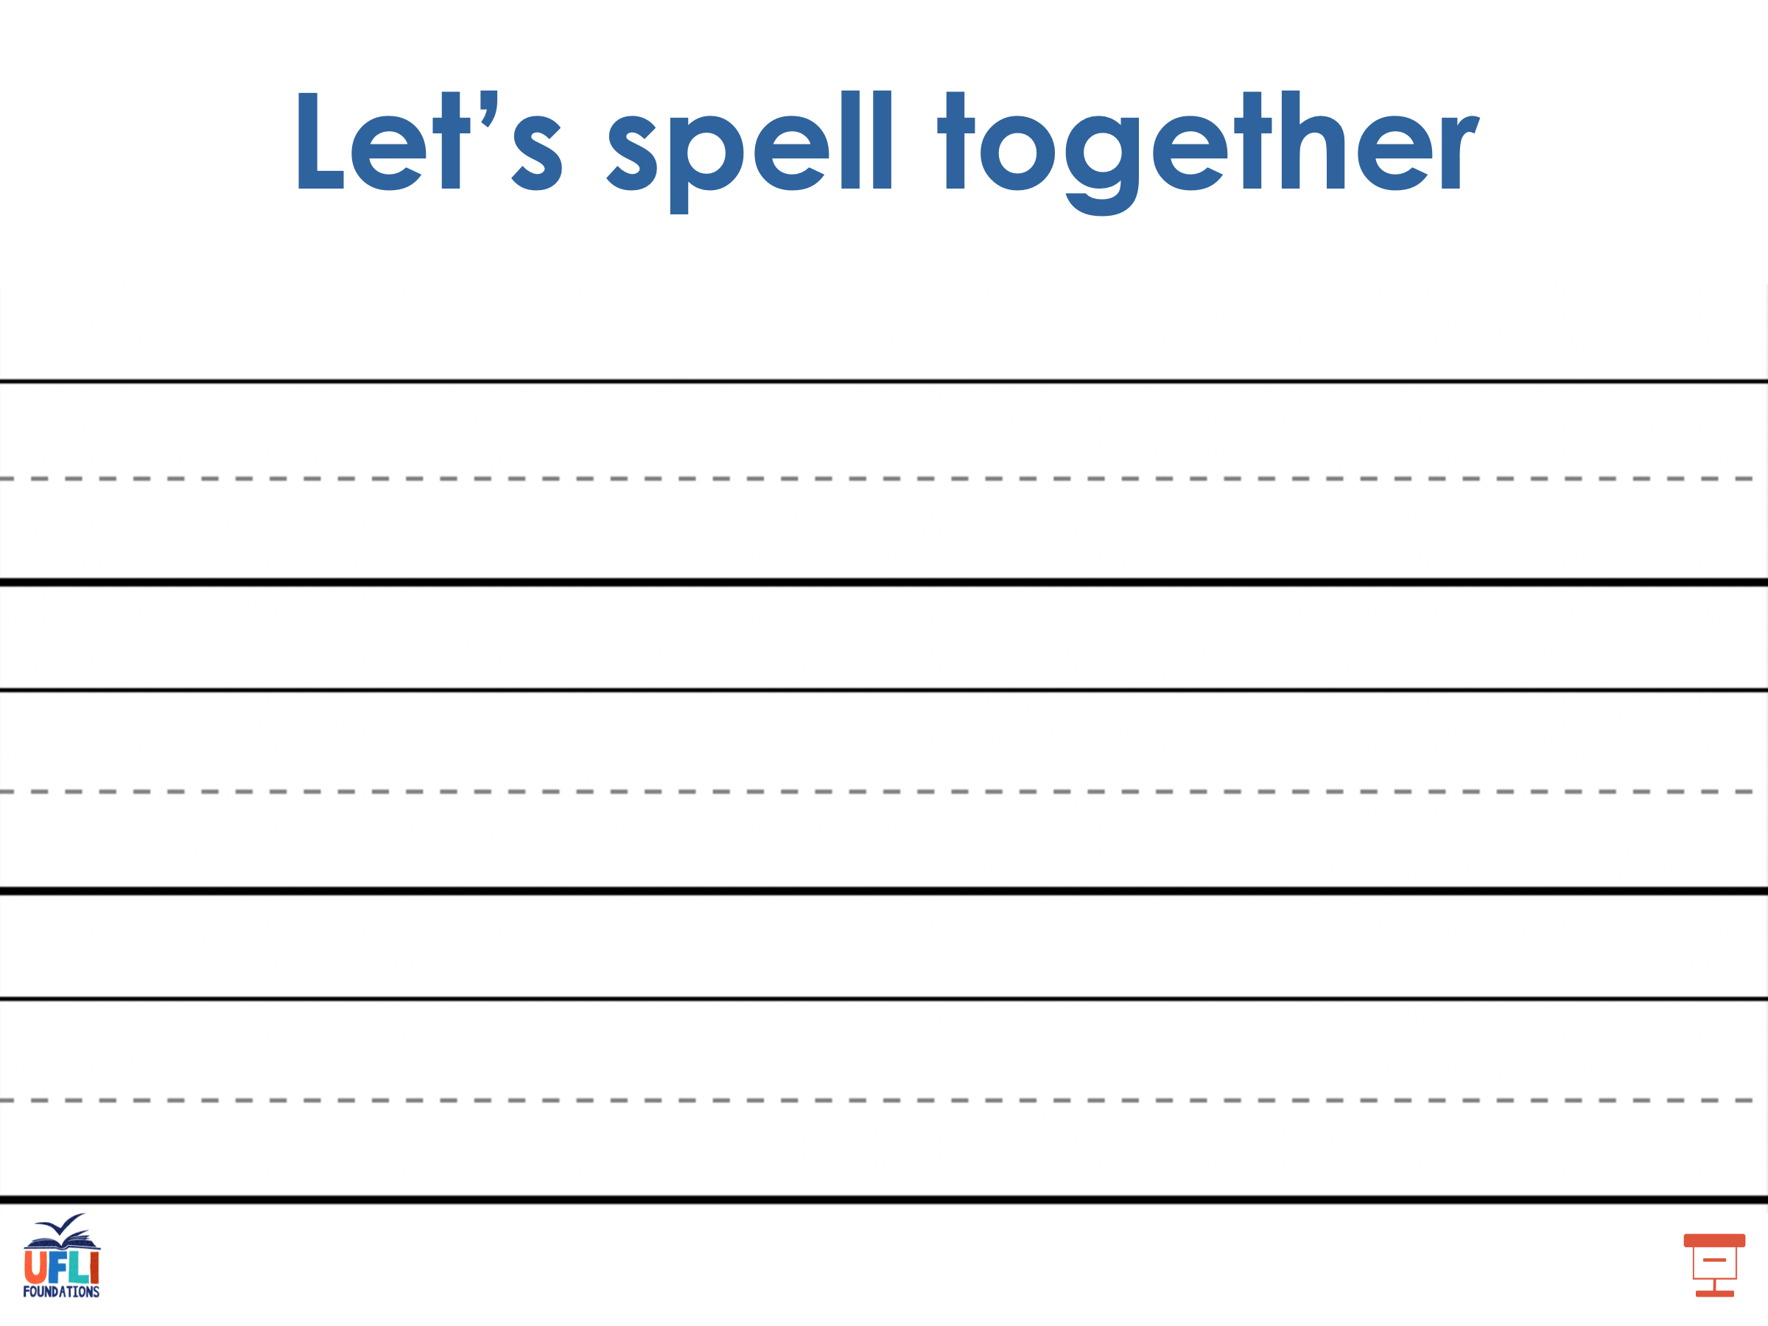
Notes:
See UFLI Foundations lesson plan Step 5 for words to spell.
Handwriting paper for guided spelling practice.

Slide 32



Slide 33

Lesson 21
-s /z/

Slide 34


New Concept Review
What did you learn?
Notes:
See UFLI Foundations lesson plan Step 5 for recommended teacher language and activities to review the new concept.

Slide 35
New Concept Review
s
Notes:
See UFLI Foundations lesson plan Step 5 for recommended teacher language and activities to review the new concept.

Slide 36
fans
pods

Slide 37
fans
pods

Slide 38
s

Slide 39
fins
bags
pens
bugs

Slide 40
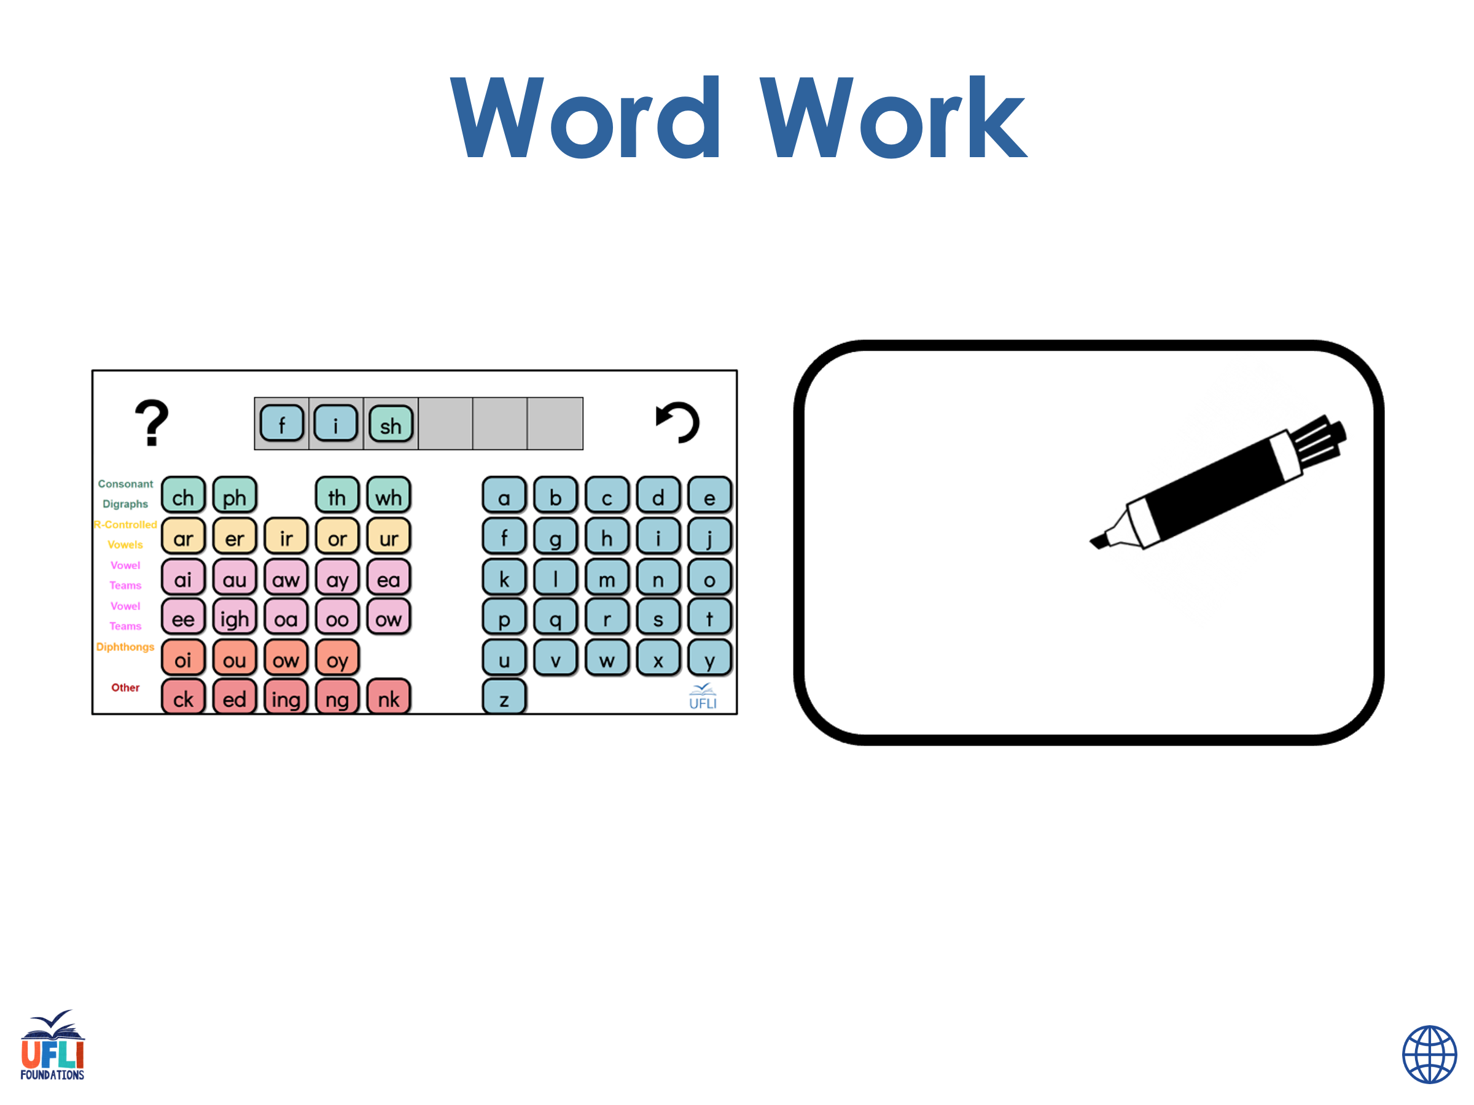
Get TILE BOARDS
I’m going to give you a word and your going to get the letters to spell it.
Sound out the Word
Say the Word
Notes:
See UFLI Foundations lesson plan Step 6 for word work activity.
Visit ufliteracy.org to access the Word Work Mat apps.

Slide 41
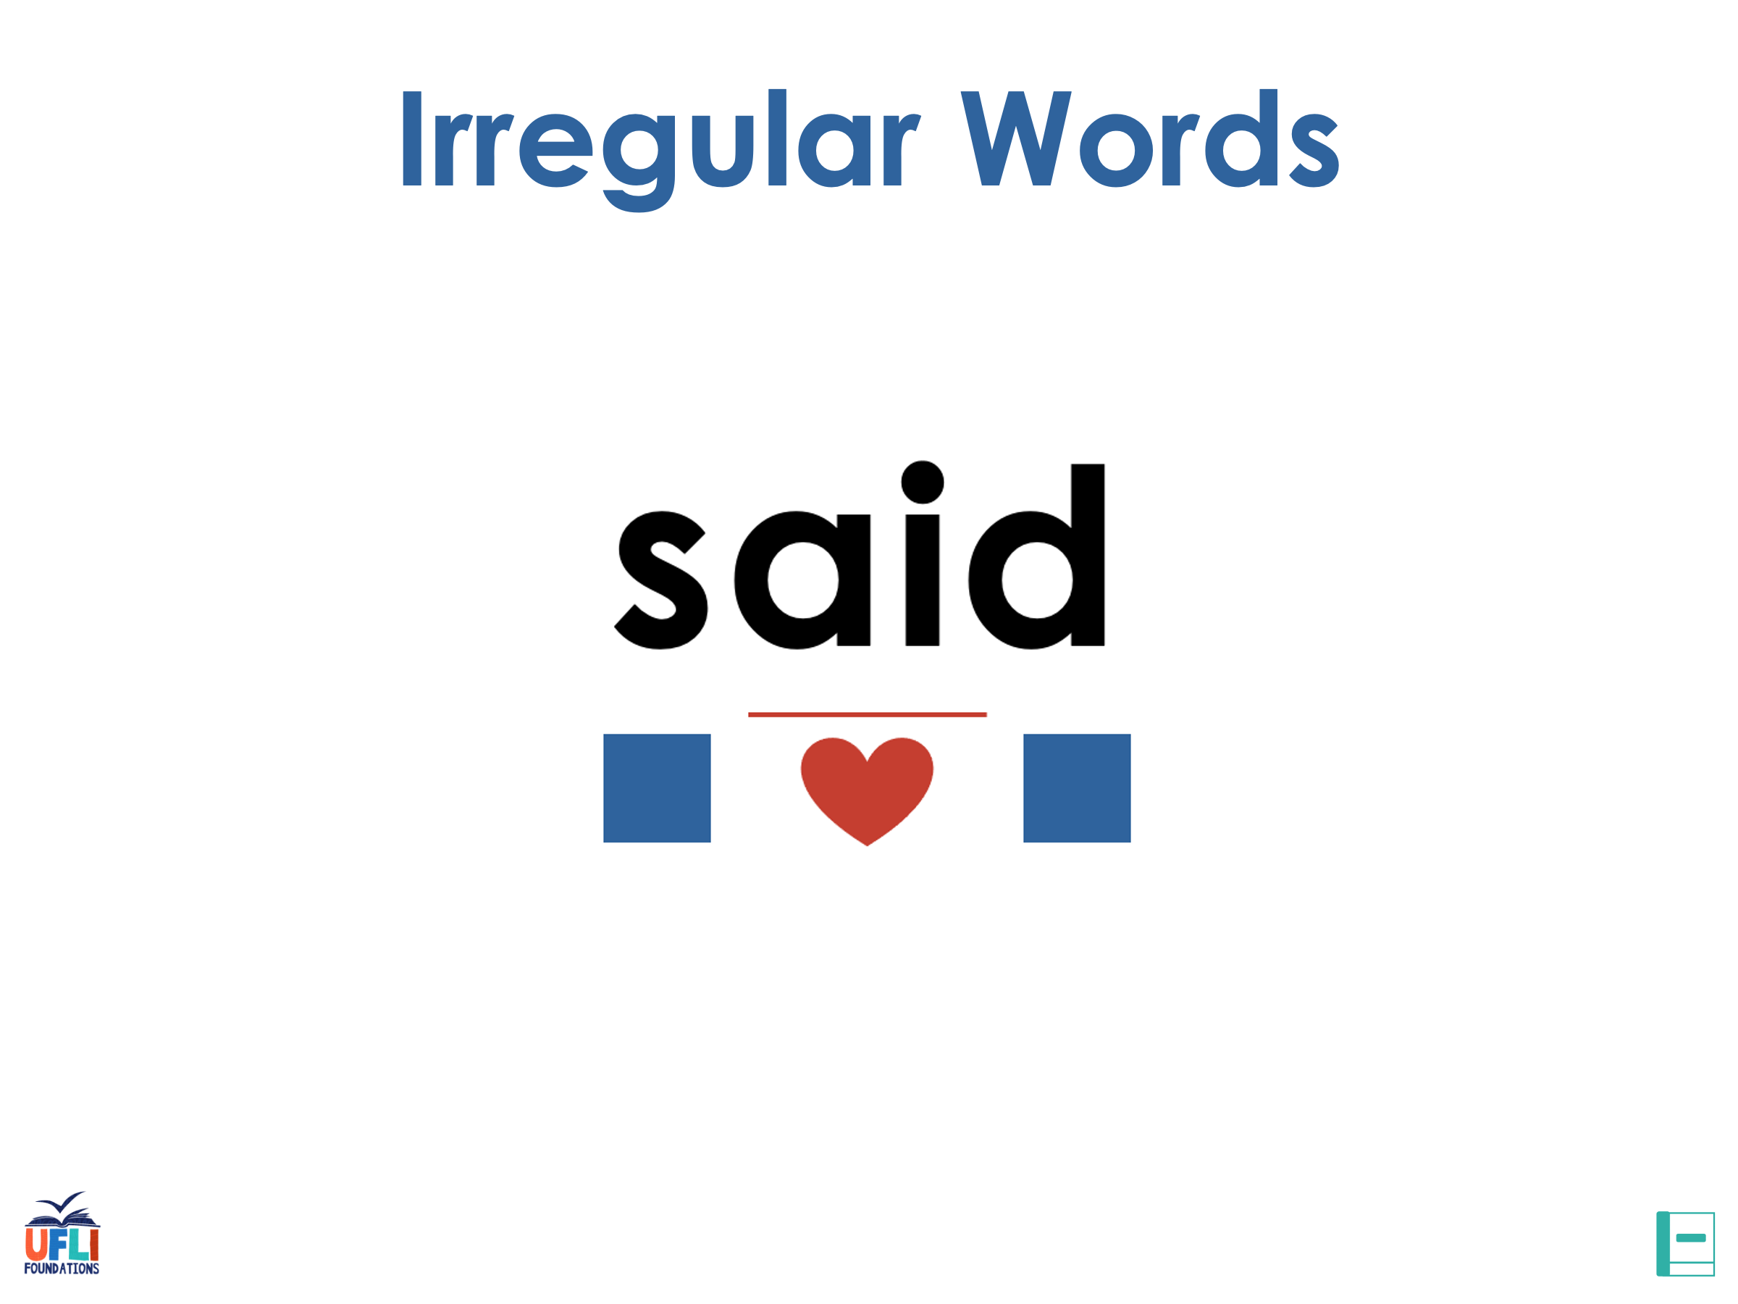
Review
Notes:
See UFLI Foundations lesson plan Step 7 for irregular word activities.
The white rectangle under each word may be used in editing mode. Cover the heart and square icons then reveal them one at a time during instruction.

Slide 42
said
Notes:
Lesson 13+
AI represents the /ĕ/ sound.
The white rectangle under the word may be used in editing mode. Cover the heart and square icons then reveal them one at a time during instruction.

Slide 43
to
Notes:
Lesson 15+
O represents the /ū/ sound.
The white rectangle under the word may be used in editing mode. Cover the heart and square icons then reveal them one at a time during instruction.

Slide 44
do
Notes:
Lesson 15+
O represents the /ū/ sound.
The white rectangle under the word may be used in editing mode. Cover the heart and square icons then reveal them one at a time during instruction.

Slide 45
of
Notes:
Lesson 17+
O represents the /ŭ/ sound.
F represents the /v/ sound.
The white rectangle under the word may be used in editing mode. Cover the heart and square icons then reveal them one at a time during instruction.

Slide 46
see
Notes:
Lessons 19-84
*Temporarily irregular
EE /ē/ has not been introduced yet.
The white rectangle under the word may be used in editing mode. Cover the heart and square icons then reveal them one at a time during instruction.

Slide 47
SPELL IRREGULAR WORDS
Notes:
Handwriting paper for irregular word spelling practice. Use as needed.
See UFLI Foundations manual for more information about reviewing irregular words.

Slide 48
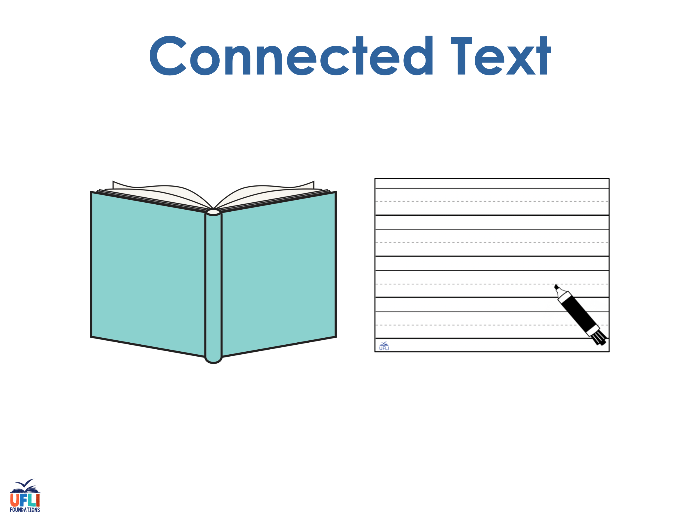
Notes:
See UFLI Foundations lesson plan Step 8 for connected text activities.

Slide 49
Dad tugs on the tag.

Slide 50
The dog is as big as Ben!

Slide 51
Nat said,“I can see ten pigs!”

Slide 52
Notes:
See UFLI Foundations lesson plan Step 8 for sentences to write.

Slide 53

Notes:
The UFLI Foundations decodable text is provided here. See UFLI Foundations decodable text guide for additional text options.

Slide 54
Cubs in the Den
Mom sees the cubs.
Mom and the cubs get in the den.
The den is big.

Slide 55
Mom sits in the den.
The cubs see bugs and bats in the den.
The cubs get the bugs.

Slide 56
The cubs do not get the bats.
Mom and the cubs nap in the den.

Slide 57
Word work chains
Now we are going to do some word chains. Here is an example:
The word is cat. Change the /c/ to a /r/.
What’s the word? Rat.
*say sound not letter word.
Now you try!

