Slide 1
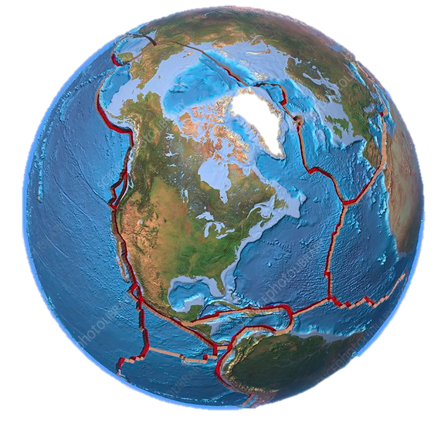
Make a Spherical Model of the Tectonic Plates
Lab created by Susan Ross, San Diego CA
Notes:
Lab creator: Susan Ross, San Diego CA | susanross2n@gmail.com

Slide 2
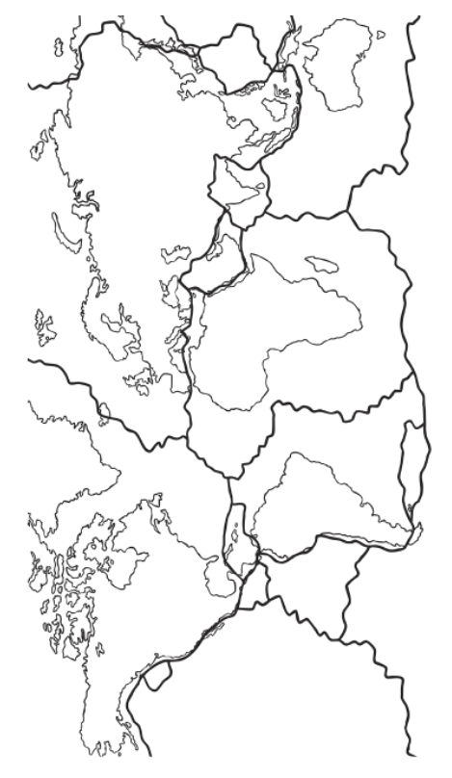
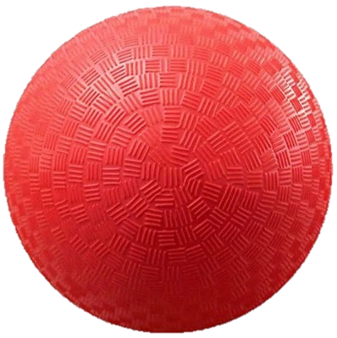
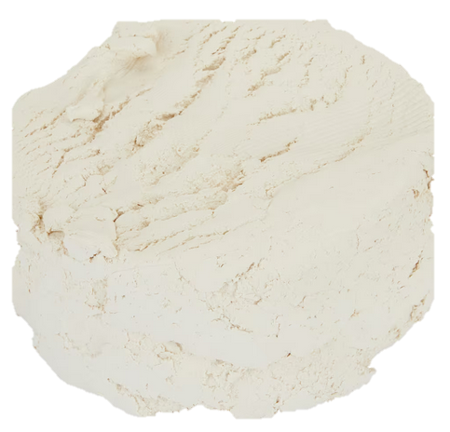
Supplies per Team
Outline of Tectonic Plates (trace or cut)
African Plate
Antarctic Plate
Arabian Plate
Australian Plate
Caribbean Plate
Cocos Plate
Eurasian Plate
Juan de Fuca Plate
Indian Plate
Nazca Plate
North American Plate
Pacific Plate
Philippine Plate
Scotia Plate
South American Plate
5” or 6” Ball
Scissors
Clay / Tracing Tools
Rolling Pin
Wax paper
Doublesided Tape
Foam Clay
(150g for 5” ball
200g for 6” ball)
List of Plate Names to cut for labeling

Slide 3
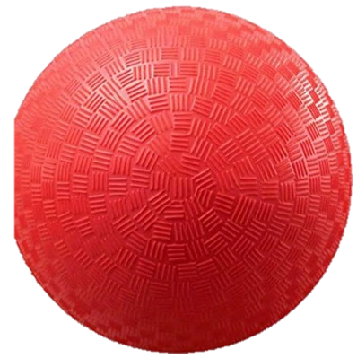
DIRECTIONS:
Roll the clay very flat (torilla or crepe thin).
Using the paper outline, form each Tectonic Plate out of the rolled clay.
Place the clay Plate carefully on the ball. Ideally, the clay Plate boundaries line up well so the ball color underneath is not visible.
To label each clay Plate, cut out the Tectonic Plate name from the list.
Affix gently the Tectonic Plate label to the clay Plate using double-sided tape.
If time allows, color your Plate Tectonics Globe
African Plate
Antarctic Plate
Arabian Plate
Australian Plate
Caribbean Plate
Cocos Plate
Eurasian Plate
Juan de Fuca Plate
Indian Plate
Nazca Plate
North American Plate
*Pacific Plate
Philippine Plate
Scotia Plate
South American Plate

Slide 4
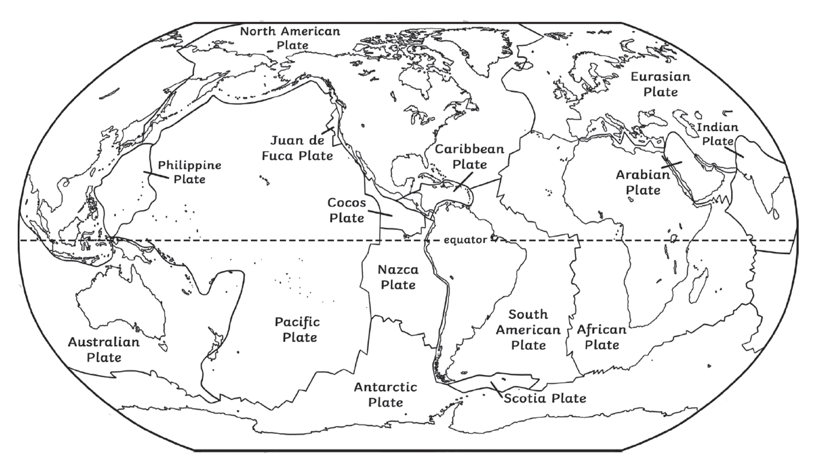
African Plate
Antarctic Plate
Arabian Plate
Australian Plate
Caribbean Plate
Cocos Plate
Eurasian Plate
Juan de Fuca Plate
Indian Plate
Nazca Plate
North American Plate
Pacific Plate
Philippine Plate
Scotia Plate
South American Plate
Directions:
Cut the Plate names from the list.
Affix to your Clay Plate on the Ball with doublesided tape
Map source: Twinkl

Slide 5
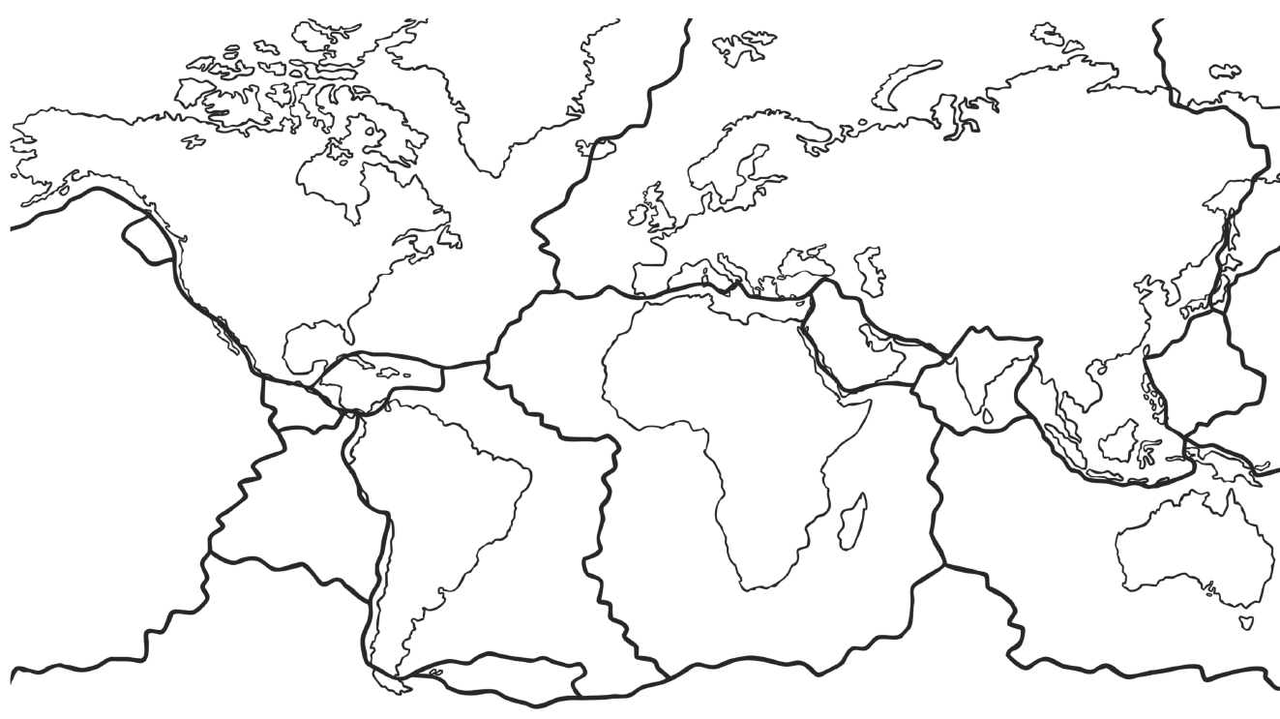
Directions: Cut or trace the outline of the Plates to make the Plates on your rolled flat Clay Plate. Make the Antarctic Plate last.
Note: The plates at both Poles will be curved on your 3D ball, not linear as shown on this 2D paper (see map on page with Plate Names List).
Map source: Twinkl

