Slide 1
Year: 2
Term: 1
Objective: To expand simple sentences with an adjective
Author: Yvonne Cooper

Slide 2












Multiple Choice
Pair Share
Track with me
Pick a Stick/Answer (non-volunteer)
Whiteboards
Vote
Read with me
In Your Workbook

Slide 3
Learning Objective
We are learning to expand simple sentences with an adjective to modify the noun/s in the sentence.
Expand means to make the sentence longer.
Nouns are words that name people, places, things, animals and ideas.
Adjectives are words that modify or describe nouns. They tell which one, how many or what kind.

Slide 4

Concept Development
A noun names a person, place, thing or idea.
An adjective is a word that modifies or describes a noun.
It describes which one, how many or what kind.
CFU:
What is the adjective in this sentence?
Which noun is being modified in this sentence?
Examples:
The motorcycle roared down the street.
The crimson motorcycle roared down the deserted street.
2. The question was about shapes.
The second question was about shapes.
3. The poster stood out amongst the others.
The bright pink poster stood out amongst the paler green ones.

Slide 5

Concept Development
A noun names a person, place, thing or idea.
An adjective is a word that modifies or describes a noun.
It describes which one, how many or what kind.
CFU:
Why is this not an example of an adjective being used to expand a sentence?
Non-Examples:
1. The dog ran down the path to its owner.
The words ‘dog’, ‘path’ and ‘owner’ are the nouns .
No adjectives have been used.
2. The children never stopped looking for their ball.
The words ‘children’ and ‘ball’ are the nouns.
No adjectives have been used.

Slide 6
Concept Development
A noun names a person, place, thing or idea.
An adjective is a word that modifies or describes a noun.
It describes which one, how many or what kind.
CFU:
What extra information is the adjective giving us? What is the adjective doing to the noun __________?
Circle the nouns.
Choose the best adjective to modify them.
The (first/red) question was about whales.
(Many/Hungry) trees lose their (funny/old) leaves in autumn.
(Sweet/Hairy) spiders make my skin crawl.

Slide 7
Concept Development
A noun names a person, place, thing or idea.
An adjective is a word that modifies or describes a noun.
It describes which one, how many or what kind.
CFU:
What extra information is the adjective giving us? What is the adjective doing to the noun __________?
Circle the nouns.
Choose the best adjective to modify them.
Remember to clean your (soggy/dirty) shoes.
Her (favorite/lost) toys were neatly put away in her bedroom.
(Next/Past) Saturday will be her (most/second) birthday.

Slide 8


Hinge Point Question
Which sentence(s) use adjectives to expand them by describing nouns?
CFU:
Why is it/ isn’t it a an example of a sentence being expanded using adjectives to describe nouns?
I like to play with the ball.
Could we all travel on the funny green bendy-bus?
Do you think such a cute furry kitten will find a safe, loving home?
I want to eat ice-cream.
Joel can throw a ball.
A noun names a person, place, thing or idea.
An adjective is a word that modifies or describes a noun.
It describes which one, how many or what kind.

Slide 9
Skill Development: I do
A noun names a person, place, thing or idea.
An adjective is a word that modifies or describes a noun.
It describes which one, how many or what kind.
CFU:
What extra information is the adjective giving us? What is the adjective doing to the noun __________?
Read the sentence carefully and identify the nouns.
Choose the best adjective to help expand each sentence.
speeding neighbor’s broken large
Throw out the _________ chair.
The _________tree was taller than the __________ house.
Did you see the ___________ car drive past?

Slide 10
Skill development: We do
Read the sentence carefully and identify the nouns.
Choose the best adjective to help expand each sentence.
CFU:
What extra information is the adjective giving us? What is the adjective doing to the noun __________?
roast tallest latest delicious solid hurt
On Friday, Mom always cooks a ____________ ___________ dinner.
The __________ tree was the scariest to climb.
Have you seen the __________ movie in the series?

Slide 11
Skill development: We do
Read the sentence carefully and identify the nouns.
Choose the best adjective to help expand each sentence.
CFU:
What extra information is the adjective giving us? What is the adjective doing to the noun __________?
rock wet funny dreary best yellow
All the _______ tickets for the ___________ concert were sold out.
It was a __________ , ___________ day and no fun at all.

Slide 12

Skill development: We do
Read the sentence carefully and identify the nouns.
Choose the best adjective to help expand each sentence.
CFU:
What adjectives could we use to modify the nouns _____________?
Have you put your clothes in the drawers yet?
Suggestions:

Slide 13
Skill development: We do
Read the sentence carefully and identify the nouns.
Choose the best adjective to help expand each sentence.
CFU:
What adjectives could we use to modify the nouns _____________?
Before we eat this dinner, we need to wash our hands.
Suggestions:

Slide 14
Skill development: I do
Read the sentence carefully and identify the nouns.
Choose the best adjective to help expand each sentence.
CFU:
What adjectives could we use to modify the nouns _____________?
I think the students enjoyed the day .

Slide 15
Skill development: We do
Read the sentence carefully and identify the nouns.
Choose the best adjective to help expand each sentence.
CFU:
What adjectives could we use to modify the nouns _____________?
I was excited to learn about the book.

Slide 16
Skill development: You do
Read the sentence carefully and identify the nouns.
Choose the best adjective to help expand each sentence.
Brainstorm your possible adjectives.
CFU:
What adjectives could we use to modify the nouns _____________?
The children wanted pencils and paper to draw with.
A noun names a person, place, thing or idea.
An adjective is a word that describes or modifies a noun or pronoun.
It describes which one, how many or what kind.

Slide 17
Skill development: You do
Read the sentence carefully and identify the nouns.
Choose the best adjective to help expand each sentence.
CFU:
What adjectives could we use to modify the nouns _____________?
The door of the house was stuck.
Suggestions:

Slide 18
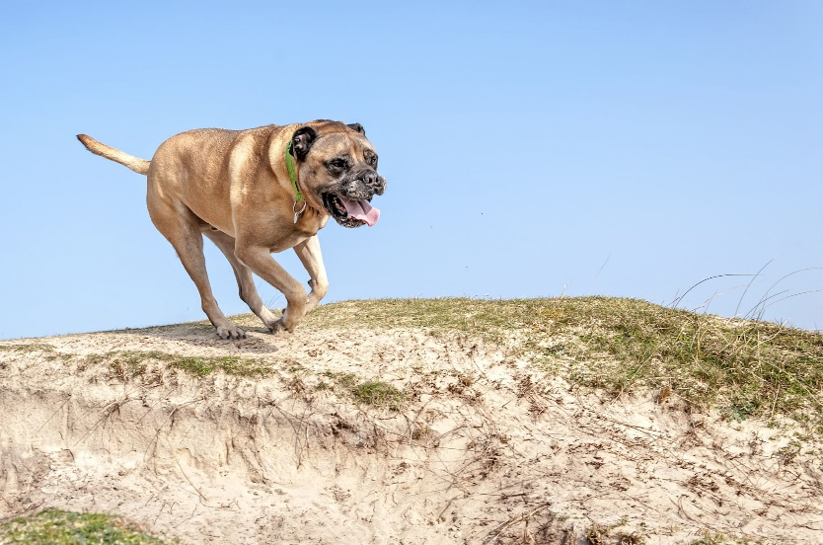
Skill development: I do
Answer the questions in note form
Use the notes to say the sentence, in this order:
Who/what (did)what where.
3. Add an adjective to the ‘who’ or the ‘where’
3. Write your sentence using correct punctuation.
Who/what (did)what where.
4. Read your sentence – does it sound right?
CFU:
What adjective did I use to modify the who (subject)?
It ran.
Who/what:
Where:
The enormous dog
towards the beach
The enormous dog ran towards the beach.

Slide 19
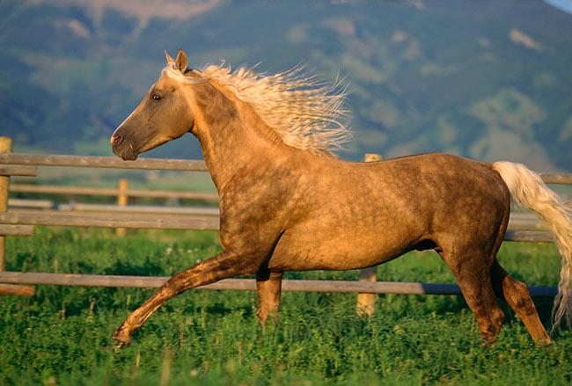
Skill development: We do
Answer the questions in note form
Use the notes to say the sentence, in this order:
Who/what (did)what where.
3. Add an adjective to the ‘who’ or the ‘where’
3. Write your sentence using correct punctuation.
Who/what (did)what where.
4. Read your sentence – does it sound right?
CFU:
What adjective did we use to modify the who (subject)? Or the where?
It galloped.
Who/what:
Where:
The beautiful horse
in the green paddock.
The beautiful horse galloped in the green paddock.

Slide 20
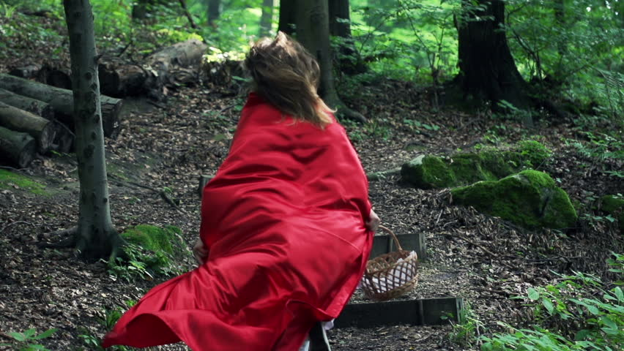
Skill development: You do
Answer the questions in note form
Use the notes to say the sentence, in this order:
Who/what (did)what where..
3. Add an adjective to the ‘who’ or the ‘where’
3. Write your sentence using correct punctuation.
Who/what (did)what where..
4. Read your sentence – does it sound right?
CFU:
What adjective did you use to modify the who (subject)? Or the where?
She darted.
Who/what:
Where:
The frightened girl
behind the spooky trees

