Slide 1
Year: 2
Term: 1
Objective: Identify and define proper and common nouns and capitalise proper nouns
Author: Stephanie Le Lievre & Todd Bates

Slide 2












Multiple Choice
Pair Share
Track with me
Pick a Stick/Answer (non-volunteer)
Whiteboards
Vote
Read with me
In Your Workbook

Slide 3
Learning Objective
We are learning identify common and proper nouns.
We are learning to capitalize proper nouns.

Slide 4



Concept Development
A noun is a person, place or thing.
CFU:
What is a noun?
Why is this an example person? Place? Thing?

Slide 5


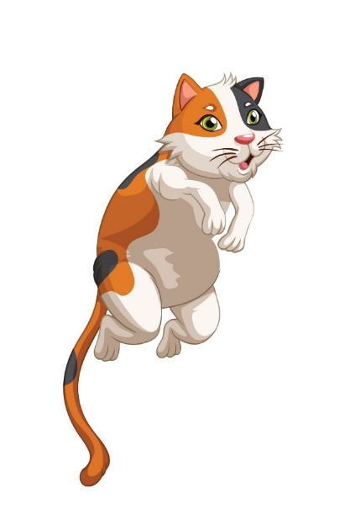
Concept Development
A noun is a person, place or thing.
CFU:
What is a noun?
Why is this an example person? Place? Thing?
Examples:
girl
The girl smiles.
cat
The cat jumps high.
Not verbs: smiles, jumps.

Slide 6
Concept Development
A common noun names a generic person, place or thing. That means, it could be any person, place or thing.
A common noun does not need a capital letter.
CFU:
What is a common noun?
Why is this an example person? Place? Thing?
doctor
teacher
house
student
flower
car
teddy
tree
beach
school

Slide 7
Concept Development
A proper noun names a specific person, place or thing. That means, it is naming a particular person, place, or thing.
A proper noun needs a capital letter.
CFU:
What is a proper noun?
Why is this an example person? Place? Thing?
Mrs. Smith
Toyota
Target
Lucy
Ocean City Beach
The Royal Show
Roblox

Slide 8
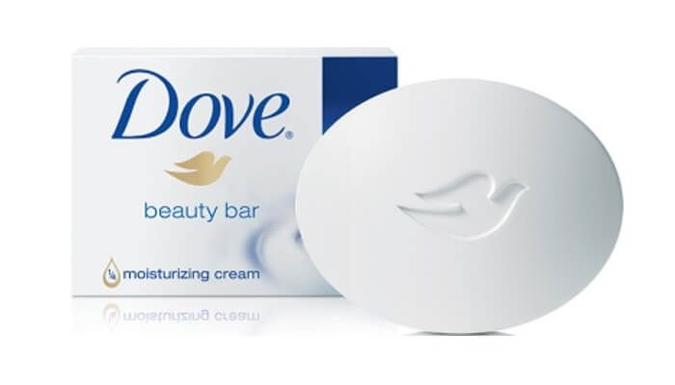
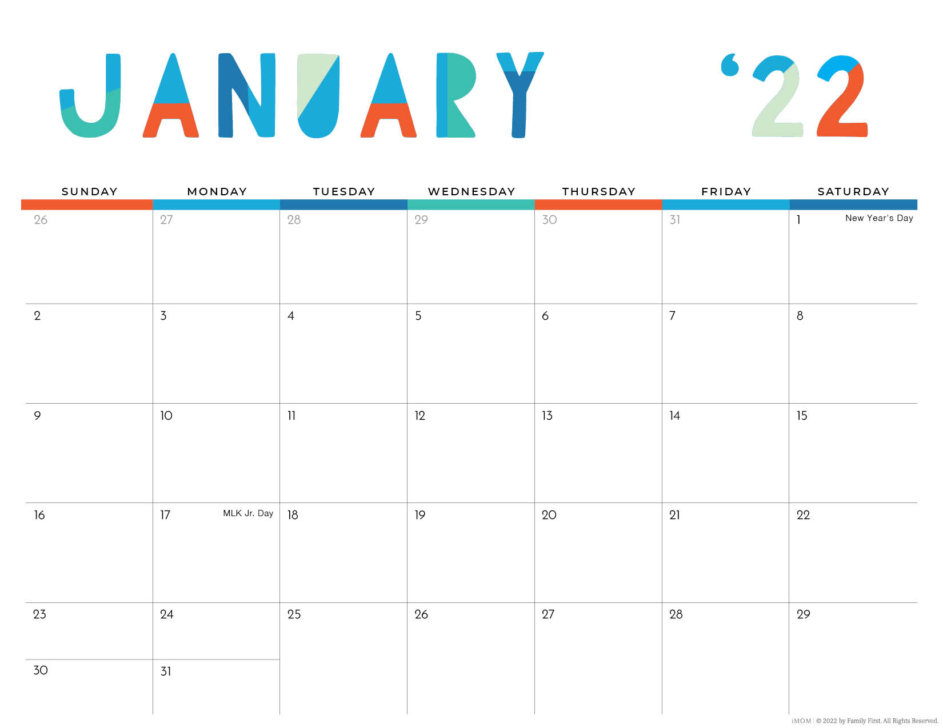
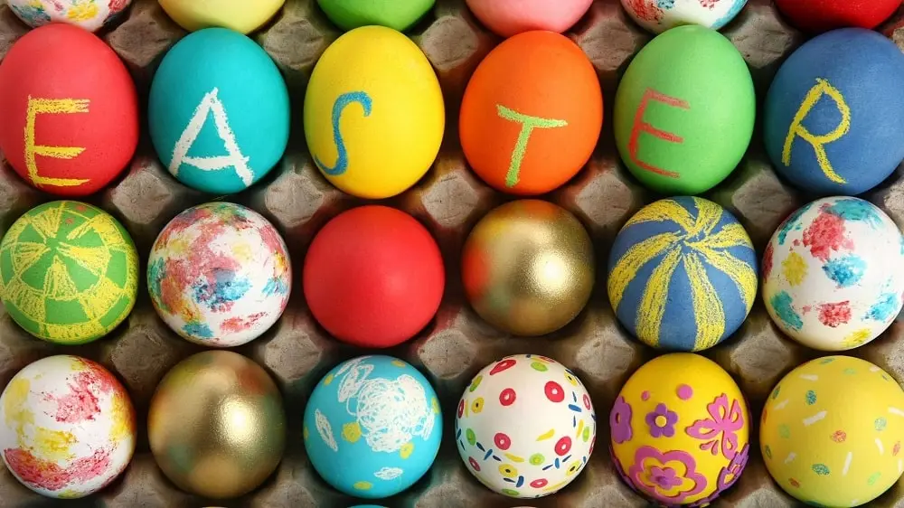
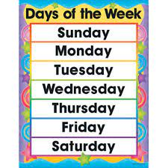
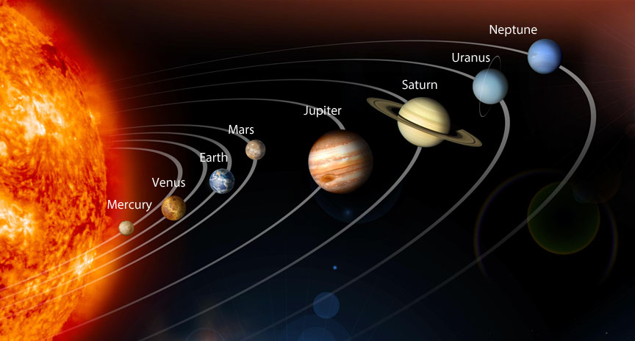
Concept Development
A proper noun names a specific person, place or thing. That means, it is naming a particular person, place, or thing.
A proper noun needs a capital letter.
CFU:
Tell your partner a proper noun
Why is it a proper noun?
Names of:
People
Places
Things
Brands
Days of the week
Months of the year
Celebrations
Planets

Slide 9
Hinge Point Question
Which are examples of proper nouns?
(None have capitals as this gives the game away!)
CFU:
Why is this an example of a proper noun?
spider
mary
Egg Harbor Township
road

Slide 10
Concept Development: I do, We do
Write a proper noun for each common noun
Remember a proper noun needs a capital letter.
CFU:
Why is it a proper name? Is it a specific _________?
Common noun | Proper Noun
teacher | Mrs. Petti
boy
girl
school
movie
store
city

Slide 11
Concept Development: You do
Write a proper noun for each common noun
Remember a proper noun needs a capital letter.
CFU:
Why is it a proper name? Is it a specific _________?
Common noun | Proper Noun
country
continent
people
city
poet
island
language

Slide 12
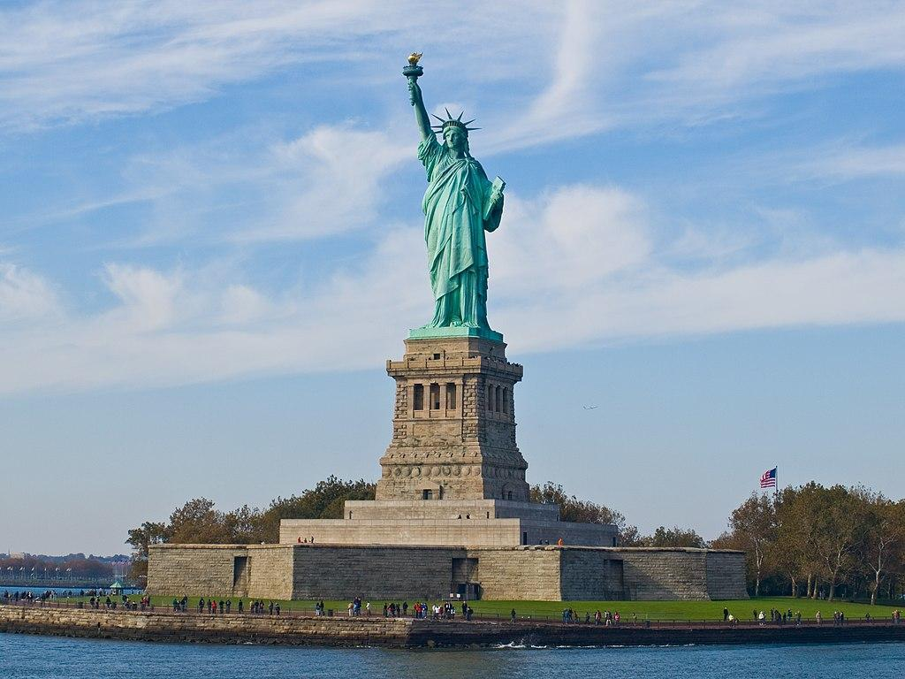
Skill Development: I do
Read the sentence.
Identify the proper noun/s.
Re-write the sentence with a capital letter for the proper noun/s.
CFU:_________?
The proper noun in this sentence is ________. I know this because _____________.
We went to the statue of liberty.
We went to the Statue of Liberty.

Slide 13

Skill Development: We do
Read the sentence.
Identify the proper noun/s.
Re-write the sentence with a capital letter for the proper noun/s.
CFU:_________?
The proper noun in this sentence is ________. I know this because _____________.
The teacher read the twits.
The teacher read The Twits.

Slide 14
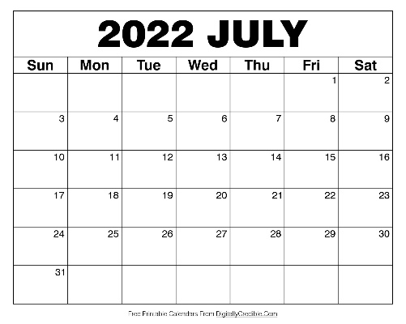
Skill Development: We do
Read the sentence.
Identify the proper noun/s.
Re-write the sentence with a capital letter for the proper noun/s.
CFU:_________?
The proper noun in this sentence is ________. I know this because _____________.
How many days does july have?
How many days does July have?

Slide 15
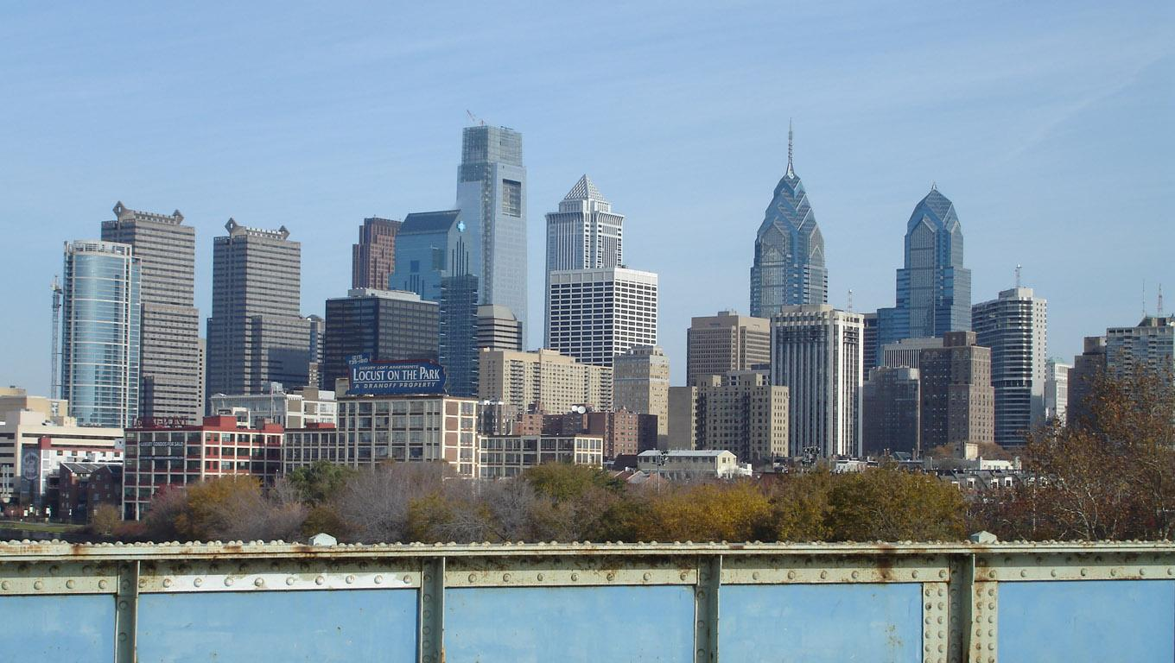
Skill Development: We do
Read the sentence.
Identify the proper noun/s.
Re-write the sentence with a capital letter for the proper noun/s.
CFU:_________?
The proper noun in this sentence is ________. I know this because _____________.
The family lived in philadelphia.
The family lived in Philadelphia.

Slide 16
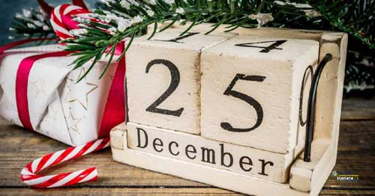
Skill Development: You do
Read the sentence.
Identify the proper noun/s.
Re-write the sentence with a capital letter for the proper noun/s.
CFU:_________?
The proper noun in this sentence is ________. I know this because _____________.
We celebrate christmas in december.
We celebrate Christmas in December.

Slide 17

Skill Development: You do
Read the sentence.
Identify the proper noun/s.
Re-write the sentence with a capital letter for the proper noun/s.
CFU:_________?
The proper noun in this sentence is ________. I know this because _____________.
luke’s birthday is in april.
Luke’s birthday is in April.

