Slide 1
Year: 3
Term: 1
Objective: Expand a sentence by adding extra information.
Author: Fiona Hart

Slide 2












Multiple Choice
Pair Share
Track with me
Pick a Stick/Answer (non-volunteer)
Whiteboards
Vote
Read with me
In Your Workbook

Slide 3
Question Words
Who/what?
(did) What?
When?
Where?
Why?
How?
Display this chart in classroom prior to lesson.
Optional: use Colourful Semantics icons in addition to question words. But please note, TWR does not distinguish between the ‘what doing/did what’ (verb) and the ‘what’ (object). If you are using a Colourful Semantics approach, you will need to consider this.

Slide 4
Learning Objective
We are learning to expand our sentences by adding extra information.

Slide 5

Activate Prior Knowledge
A sentence is a complete thought.
It must contain a subject and a verb.
CFU:
Tell me the subject.
Tell me the verb.
Examples:
Boring !
She ran.
Bob ate.
Joe napped.
These sentences are boring and do not contain any additional information.

Slide 6
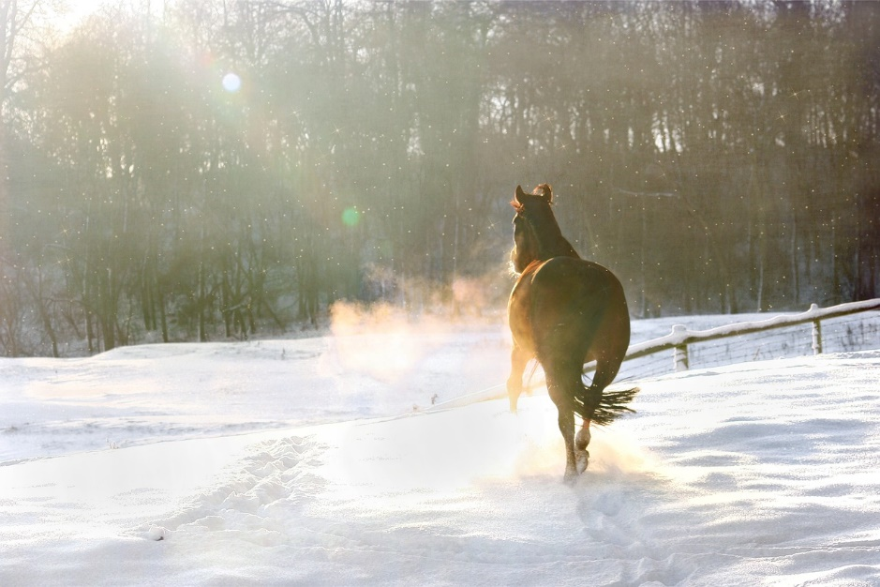

Concept Development
By adding additional information, we can expand sentences to make them more interesting.
Including when, who/what, (did) what, where, why and/or how will make your sentence more informative for the reader:
CFU: Vote
1st Sentence / 2nd Sentence
Does this sentence tell me who/what/where/when/why?
On a bitterly cold day, the horse ran through the snow because it had spotted some hay.
Boring !
It ran.

Slide 7

Concept Development
By adding additional information, we can expand sentences to make them more interesting.
Including when, who/what, (did) what, where, why and/or how will make your sentence more informative for the reader:
CFU: Vote
1st Sentence / 2nd Sentence
Does this sentence tell me who/what/where/when/why/how?
When?
Where?
Who?
What?
Why?
When the sun rises, the ice slowly drips onto the snow because it is melting.
It drips.
Uninformative !

Slide 8
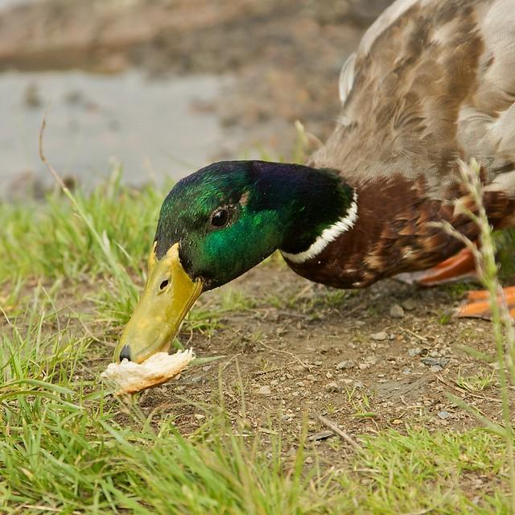
Skill development: I do
Answer the questions in note form
Use the notes to say the sentence, in this order:
When, who/what (did)what where why.
3. Write your sentence using correct punctuation.
When, who/what (did)what where why.
4. Read your sentence – does it sound right?
CFU:
Tell me who.
Tell me what.
Tell me when.
Tell me where.
Tell me why.
Say the expanded sentence.
It was eating.
When? ........................................
Who/what? ……………………………………..
Where? ...…………………………………..
Why? ………………………………………
overcast morning
a duck
muddy riverbank
it was hungry
One overcast morning, a duck was eating bread on a muddy riverbank because it was hungry.

Slide 9
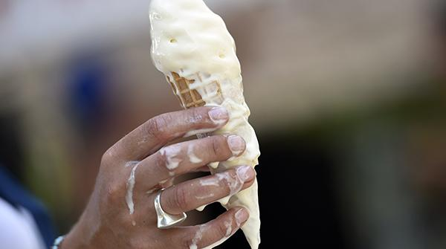
Skill development: We do
Answer the questions in note form
Use the notes to say the sentence, in this order:
When, who/what (did)what where why.
3. Write your sentence using correct punctuation.
When, who/what (did)what where why.
4. Read your sentence – does it sound right?
CFU:
Tell me who.
Tell me what.
Tell me when.
Tell me where.
Tell me why.
Say the expanded sentence.
It melted.
When? ........................................
Who/what? ……………………………………..
Where? ...…………………………………..
Why? ………………………………………
On a warm night, the vanilla ice cream melted over the girl’s fingers because she did not eat it fast enough. (anticipated/encouraged response suggestion)

Slide 10
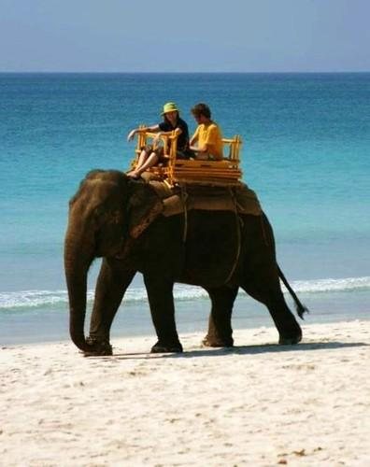
Skill development: I do
Answer the questions in note form
Use the notes to say the sentence, in this order:
When, who/what (did)what how where.
3. Write your sentence using correct punctuation.
When, who/what (did)what how where.
4. Read your sentence – does it sound right?
CFU:
Tell me who.
Tell me what.
Tell me when.
Tell me where.
Tell me how.
Say the expanded sentence.
She trudged.
When? ........................................
Who/what? ……………………………………..
Where? ...…………………………………..
How? ………………………………………
scorching day
elephant
along beach
slowly
On a scorching hot day, an elephant trudged slowly along the beach.

Slide 11

Skill development: We do
Answer the questions in note form
Use the notes to say the sentence, in this order:
When, who/what (did)what how where.
3. Write your sentence using correct punctuation.
When, who/what (did)what how where.
4. Read your sentence – does it sound right?
CFU:
Tell me who.
Tell me what.
Tell me when.
Tell me where.
Tell me how.
Say the expanded sentence.
She yawned.
When? ........................................
Who/what? ……………………………………..
Where? ...…………………………………..
How? ………………………………………
In the morning, the woman yawned loudly in the office. (anticipated/encouraged response suggestion)

Slide 12
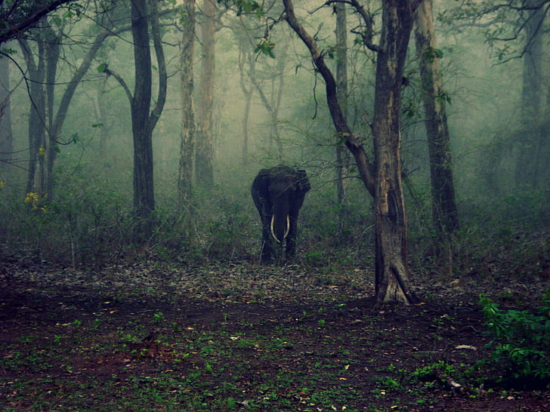
Skill development: You do
Answer the questions in note form
Use the notes to say the sentence, in this order:
When, who/what (did)what how where.
3. Write your sentence using correct punctuation.
When, who/what (did)what how where.
4. Read your sentence – does it sound right?
It wandered.
When? ........................................
Who/what? ……………………………………..
Where? ...…………………………………..
How? ………………………………………
At dusk, the majestic beast meandered peacefully in the jungle. (Anticipated/suggested response)

Slide 13

Skill development: You do
Answer the questions in note form
Use the notes to say the sentence, in this order:
When, who/what (did)what where why.
3. Write your sentence using correct punctuation.
When, who/what (did)what where why.
4. Read your sentence – does it sound right?
He cheered.
When? ........................................
Who/what? ……………………………………..
Where? ...…………………………………..
Why? ………………………………………

Slide 14
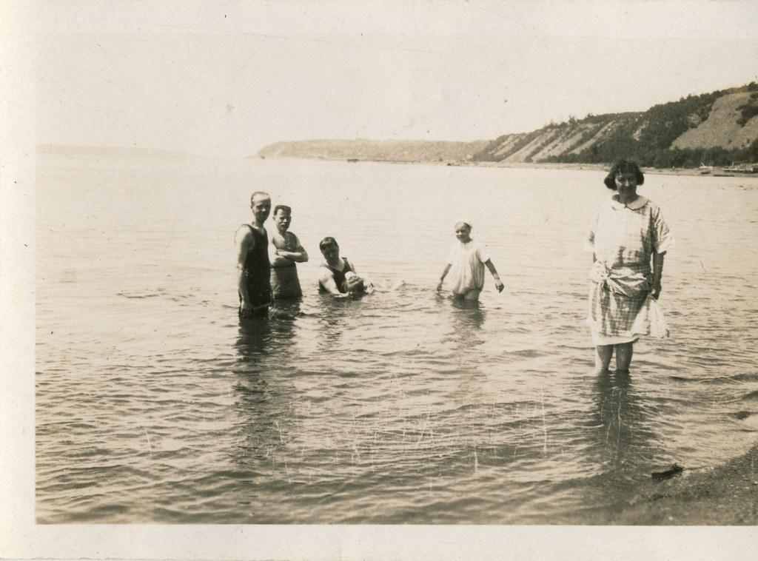
Skill development: You do
Answer the questions in note form
Use the notes to say the sentence
Write your sentence using correct punctuation.
4. Read your sentence – does it sound right?
They swam.
When? ........................................
Who/what? ……………………………………..
Where? ...…………………………………..
Why? ………………………………………
How? ………………………………………
Many years ago, the family swam playfully in the ocean because the weather was warm and they did not have air-conditioning at home. (Anticipated/suggested response)

Slide 15
Skill development: You do
Answer the questions in note form
Use the notes to say the sentence
Write your sentence using correct punctuation.
4. Read your sentence – does it sound right?
When? ........................................
Who/what? ……………………………………..
Where? ...…………………………………..
Why? ………………………………………
How? ………………………………………

