Slide 1
Year: 2 / 3
Term:
Objective: Identify 4 sentence types and write a sentence for each type for an image or topic
Author: Penny Blomfield and Stephanie Le Lievre

Slide 2












Multiple Choice
Pair Share
Track with me
Pick a Stick/Answer (non-volunteer)
Whiteboards
Vote
Read with me
In Your Workbook

Slide 3
Learning Objective
We are learning to identify the four sentence types.
We are learning to write statements, questions, commands and exclamations.

Slide 4





Concept Development
A sentence is a group of words that makes sense by itself.
It has a subject (what/who the sentence is about) and a verb (what the subject does, is or has).
It starts with a capital and ends with a punctuation mark.
Does it…
make sense?
have a subject?
have a verb?
begin with a capital letter?
end with a full stop, exclamation mark or question mark?

Slide 5
Concept Development
CFU:
How many types of sentences are there?
What are they?
There are 4 different sentence types:
statement
question
command
exclamation
Each sentence type is used for a different purpose.

Slide 6
Concept Development
A statement sentence gives an idea or argument.
  The Serpentine Falls are in the Serpentine National Park.
A question sentence asks something.
  Have you ever been to the Serpentine Falls?
A command sentence gives instructions or expresses a request or command.
  Go and visit the Serpentine Falls.
An exclamation expresses force or strong emotion.
  We must protect the Serpentine Falls!

Slide 7

Concept Development
A statement gives an idea or argument.
It ends in a full stop.
CFU:
What does a statement do?
The children were playing in the park.
They crept behind the shed.
Crocodiles belong to the reptile class.
Dogs are better than cats.
Can add in sentences based on topics taught in class.

Slide 8

Concept Development
A question asks something.
It ends with a question mark.
CFU:
What does a question do?
How are mountains formed?
What should be have for dinner?
Are dogs better than cats?.
What can we do to reduce waste?
Can add in sentences based on topics taught in class.

Slide 9
Concept Development
A command gives instructions or expresses a request or command.
It ends in a full stop.
CFU:
What does a statement do?
Pick up your rubbish.
Don’t litter.
Go to the office.
Clean your room.
Can add in sentences based on topics taught in class.

Slide 10

Concept Development
A exclamation expresses force or strong emotion.
It ends with an exclamation mark.
CFU:
What does an exclamation do?
What a beautiful day!
It’s freezing cold!
That hurt!
We won the swimming carnival!
Can add in sentences based on topics taught in class.

Slide 11
Hinge Point Question
Label each sentence as S, Q, C, E
(statement, question, command, exclamation)
(punctuation mark has not been included)
Help me
Echidnas lay eggs
When should children be allowed phones
Put your name on the top of your page
E
S
Q
C

Slide 12
Skill Development: I do, We Do
Identify the sentence type (punctuation mark has not been included- it gives the game away!)
Re-write the sentence with the correct punctuation mark.
CFU:
What sentence type? How can you tell?
What punctuation mark do you need to add?
Don’t put food in the bin
I cant wait
Crocodiles are an ancestor of dinosaurs
How can we save the planet
command
Don’t put food in the bin.
exclamation
I can’t wait!
statement
Crocodiles are an ancestor of dinosaurs.
question
How can we save the planet?

Slide 13
Skill Development: I do, We do
Identify the sentence type (punctuation mark has not been included- it gives the game away!)
Re-write the sentence with the correct punctuation mark.
CFU:
What sentence type? How can you tell?
What punctuation mark do you need to add?
Where is the closest shopping centre
What is your favourite subject at school
It’s so hot, I can barely breathe
That’s outrageous
question
Where is the closest shopping centre?
question
What is your favourite subject at school?
exclamation
It’s so hot, I can barely breathe!
exclamation
That’s outrageous!

Slide 14
Concept Development: re-explanation
Skill Development: You do
Identify the sentence type (punctuation mark has not been included- it gives the game away!)
Re-write the sentence with the correct punctuation mark.
CFU:
What sentence type? How can you tell?
What punctuation mark do you need to add?
Replaces sentences with sentences from texts used in class.
Where is the closest shopping centre
What is your favourite subject at school
It’s so hot, I can barely breathe
That’s outrageous
question
Where is the closest shopping centre?
question
What is your favourite subject at school?
exclamation
It’s so hot, I can barely breathe!
exclamation
That’s outrageous!

Slide 15

Skill Development: I do
Write a statement, question, command and exclamation based on the image provided:
CFU:
What sentence type is this?
The girl is walking along the path.
Where is the girl going?
Don’t stray from the path.
Hurry up!

Slide 16

Skill Development: We do
Write a statement, question, command and exclamation based on the image provided:

Slide 17
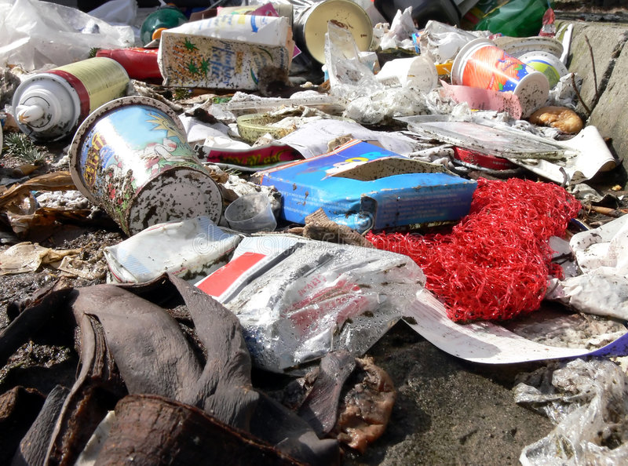
Skill Development: We do
Write a statement, question, command and exclamation based on the image provided:

Slide 18
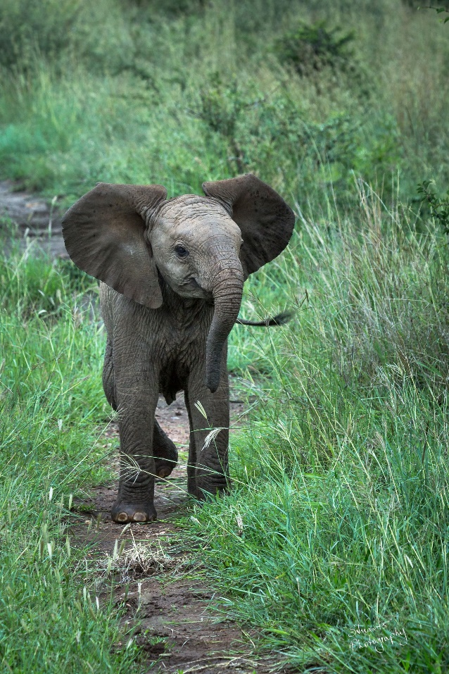
Skill Development: You do
Write a statement, question, command and exclamation based on the image provided:

Slide 19
Skill Development: You do
Write a statement, question, command and exclamation based on the image provided:
Can add in pictures based on topics taught in class.

