Slide 1
Year: 2
Term: 3
Objective: Expand a simple sentence with a fronted adverbial phrase/adverb
Author: Hayley Howard, Nicole Page and Michelle Thomas

Slide 2












Multiple Choice
Pair Share
Track with me
Pick a Stick/Answer (non-volunteer)
Whiteboards
Vote
Read with me
In Your Workbook

Slide 3
Learning Objective
We are learning to expand a simple sentence that begin with a fronted adverbial phrase or adverb.

Slide 4
Concept Development
A verb is an action to show what the subject is doing.
CFU:
What is a verb?
What is an adverb?
What is an adverbial phrase?
An adverb is a word that modifies the verb.
An adverbial phrase is a group of words that modifies the verb.
A fronted adverb or adverbial phrase are words or phrases at the beginning of a sentence which are used to describe the action that follows.

Slide 5
Concept Development
A fronted adverb or adverbial phrase are words or phrases at the beginning of a sentence which are used to describe the action that follows.
A fronted adverbial phrase can describe time (when), place (where) or manner (how)
CFU:
What is a verb?
What is an adverb?
What is an adverbial phrase?
Time
Place
Manner
Afterwards
Already
Today
Last month
Now
Soon
Here
Outside
Over there
There
Under the ground
Upstairs
Sadly
Slowly
Happily
Awkwardly
Without a sound

Slide 6

Concept Development
A fronted adverb or adverbial phrase are words or phrases at the beginning of a sentence which are used to describe the action that follows.
A fronted adverbial phrase can describe time (when), place (where) or manner (how)
CFU:
Where in a sentence does a fronted adverbial phrase / adverb go?
What does a fronted adverbial phrase / adverb describe?
How do you know this sentence has been expanded with a fronted adverbial phrase / adverb?
}
She ran.
Simple sentence
boldly bravely
How? ………………..
Boldly and bravely, she ran.
Expanded sentence using a fronted adverbial phrase
occasionally
When? ………………..
Occasionally, she runs.
Expanded sentence using a fronted adverbial phrase
down the stairs
Where? ………………..
Down the stairs, she ran.
Expanded sentence using a fronted adverbial phrase

Slide 7

Concept Development
A fronted adverb or adverbial phrase are words or phrases at the beginning of a sentence which are used to describe the action that follows.
A fronted adverbial phrase can describe time (when), place (where) or manner (how).
CFU:
Why is this not an example of a sentence expanded with a fronted adverbial phrase / adverb?
}
She ran.
Simple sentence
Non-Examples:
She runs in the morning.
The sentence is expanded but it does not include a fronted adverbial phrases.
The girl walked.
The meaning of this sentence has been changed. It not an example of how the simple sentence could be expanded.

Slide 8
Concept Development
A fronted adverb or adverbial phrase are words or phrases at the beginning of a sentence which are used to describe the action that follows.
A fronted adverbial phrase can describe time (when), place (where) or manner (how).
CFU:
What is the fronted adverb?
Is the adverb describing how, when or where?
Write the expanded sentences
Underline the fronted adverb
Circle the capital, comma and full stop
}
My aunt sat snoring.
Simple sentence
Obnoxiously, my aunt sat snoring.
Last night, my aunt sat snoring.
In the arm chair, my aunt sat snoring.

Slide 9


Hinge Point Question
Which sentences are examples of simple sentence expansion using a fronted adverbial phrases?
CFU:
Why is it/ isn’t it a an example of a sentence expanded with a fronted adverbial phrase?
}
I studied.
Simple sentence
Attentively, I studied.
At 4 in the morning, I studied.
I studied in my bedroom.
I studied attentively for my spelling test
A fronted adverb or adverbial phrase are words or phrases at the beginning of a sentence which are used to describe the action that follows.
A fronted adverbial phrase can describe time (when), place (where) or manner (how)

Slide 10
Concept Development- re-explanation
A fronted adverb or adverbial phrase are words or phrases at the beginning of a sentence which are used to describe the action that follows.
A fronted adverbial phrase can describe time (when), place (where) or manner (how).
CFU:
What is the fronted adverb?
Is the adverb describing how, when or where?
Write the expanded sentences
Underline the fronted adverb
Circle the capital, comma and full stop
}
He ate his breakfast.
Simple sentence
Early this morning, he ate his breakfast.
Messily and distractedly, he ate his breakfast.
At the cafe, he ate his breakfast.

Slide 11
Skill development: I do
Read the simple sentence
Select the fronted adverbial phrase
Rewrite the expanded sentence
Ensure capitalisation, comma and full stop
CFU:
What’s the fronted adverbial phrase / adverb?
Is the adverb describing how, when or where?
I ate cereal.
fruit, toast and bacon,
at the dining table,
This morning,
This morning, I ate cereal.

Slide 12
Skill development: We do
Read the simple sentence
Select the fronted adverbial phrase
Rewrite the expanded sentence
Ensure capitalisation, comma and full stop
CFU:
What’s the fronted adverbial phrase / adverb?
Is the adverb describing how, when or where?
I crept into the cinema.
Nervously,
A large popcorn,
Without a sound,
Without a sound, I crept into the cinema.

Slide 13
Skill development: We do
Read the simple sentence
Select the fronted adverbial phrase
Rewrite the expanded sentence
Ensure capitalisation, comma and full stop
CFU:
What’s the fronted adverbial phrase / adverb?
Is the adverb describing how, when or where?
She swam in the lake.
Effortlessly,
In the evenings,
Begrudgingly,
In the evenings, she swam in the lake.

Slide 14
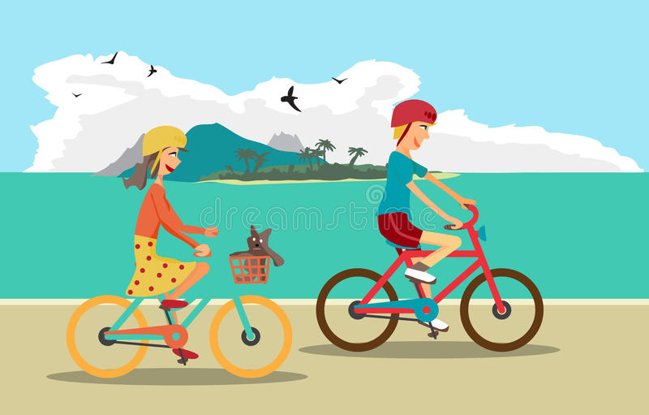
Skill development: I do
Look at the illustration
Read the simple sentence
Answer the question to develop a fronted adverbial phrase / adverb
Expand the simple sentence
Ensure capitalisation, comma and full stop
CFU:
What other adverbs could you use to describe the where?
They rode their bikes.
Where? ………………..
On the island, they rode their bikes.

Slide 15
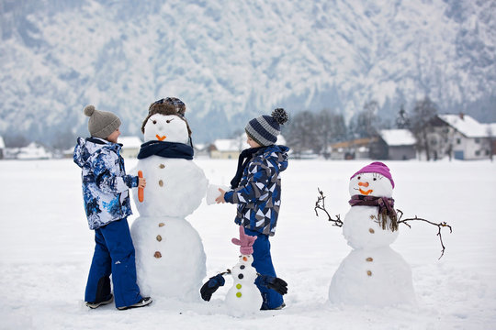
Skill development: We do
Look at the illustration
Read the simple sentence
Answer the question to develop a fronted adverbial phrase / adverb
Expand the simple sentence
Ensure capitalisation, comma and full stop
CFU:
What other adverbs could you use to describe the when?
The children built a snowman.
When? ………………..
This winter, the children built a snowman.

Slide 16
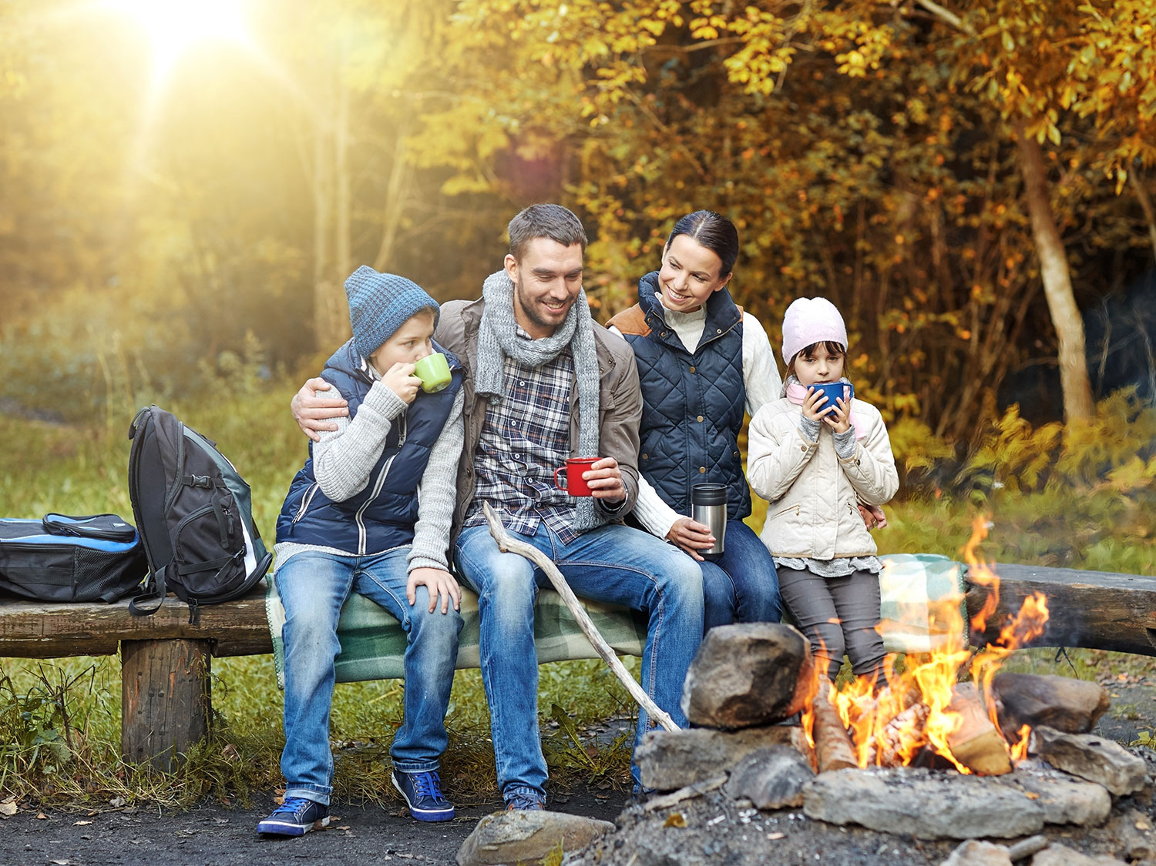
Skill development: We do
Look at the illustration
Read the simple sentence
Answer the question to develop a fronted adverbial phrase / adverb
Expand the simple sentence
Ensure capitalisation, comma and full stop
CFU:
What other adverbs could you use to describe the how?
We ate toasted marshmallows.
How? ………………..
Cosily and happily, we ate toasted marshmallows.

Slide 17
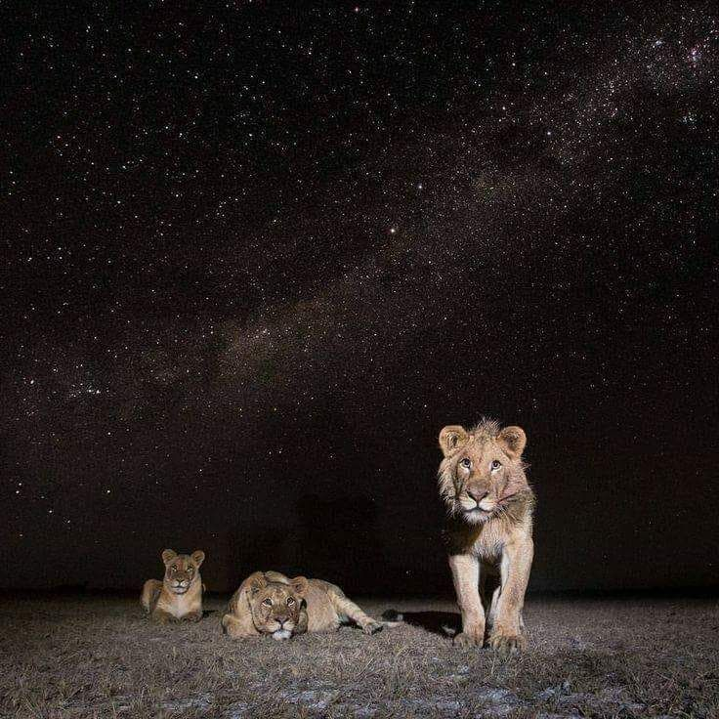
Skill development: We do
Look at the illustration
Read the simple sentence
Answer the question to develop a fronted adverbial phrase / adverb
Expand the simple sentence
Ensure capitalisation, comma and full stop
CFU:
What other adverbs could you use to describe the where?
The lions rested.
Where? ………………..
Under the stars, the lions rested.

Slide 18

Skill development: You do
Look at the illustration
Read the simple sentence
Answer the question to develop a fronted adverbial phrase / adverb
Expand the simple sentence
Ensure capitalisation, comma and full stop
CFU:
What other adverbs could you use to describe the when?
The children bounced on the trampoline.
When? ………………..
After school, the children bounced on the trampoline.

Slide 19

Skill development: You do
Look at the illustration
Read the simple sentence
Answer the question to develop a fronted adverbial phrase / adverb
Expand the simple sentence
Ensure capitalisation, comma and full stop
CFU:
What other adverbs could you use to describe the how?
She practiced yoga.
How? ………………..
Effortlessly, she practiced yoga.

Slide 20
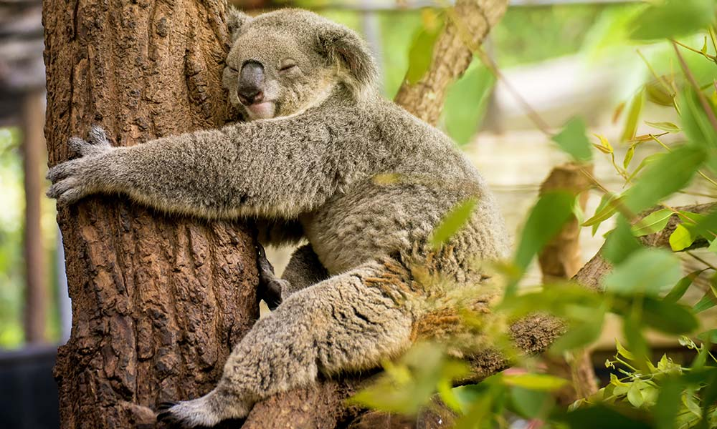
Skill development: You do
Look at the illustration
Read the simple sentence
Answer the question to develop a fronted adverbial phrase / adverb
Expand the simple sentence
Ensure capitalisation, comma and full stop
CFU:
What other adverbs could you use to describe the where?
The koala napped.
Where? ………………..
In the tree, the koala napped.

Slide 21
Skill development: You do
Look at the illustration
Read the simple sentence
Answer the question to develop a fronted adverbial phrase / adverb
Expand the simple sentence
Ensure capitalisation, comma and full stop
CFU:
What other adverbs could you use to describe the where, how, or when?
Add a sentence.
Where/how/when? ………………..

