Slide 1
Year: 2
Term: 2
Objective: Develop questions given a picture of text material- who, what, where, when, how
Author: Teagan Dunning

Slide 2












Copy and paste these icons to the appropriate slides to indicate engagement norms/CFU strategies
Multiple Choice
Pair Share
Track with me
Pick a Stick/Answer (non-volunteer)
Whiteboards
Vote
Read with me
In Your Workbook

Slide 3
Learning Objective
We are learning to develop questions given a picture of text material- who, what, where, when, how

Slide 4

Concept Development
A question sentence asks something where an answer is expected.
A question sentence ends with a question mark.
Question sentences often ask – who, what, when, where or how.
CFU:
What is a question sentence?
Why is this an example of a question sentence?
What punctuation mark is at the end?
Examples:
Who is that woman?
Where is the bathroom?
What time is it?
When does the bell go?
How did you do that?
Notes:
Question or Interrogative

Slide 5

Concept Development
A question sentence asks something where an answer is expected.
A question sentence ends with a question mark.
Question sentences often ask – who, what, when, where or how.
CFU:
Why is this not an example of a question sentence?
Non-Examples:
I have red hair.
It is a statement, not a question. It tells you something, it doesn’t ask you something.
Give me a lolly.
It is a command, not a question. It tells you to do something, it doesn’t ask you something.
Notes:
Question or Interrogative

Slide 6
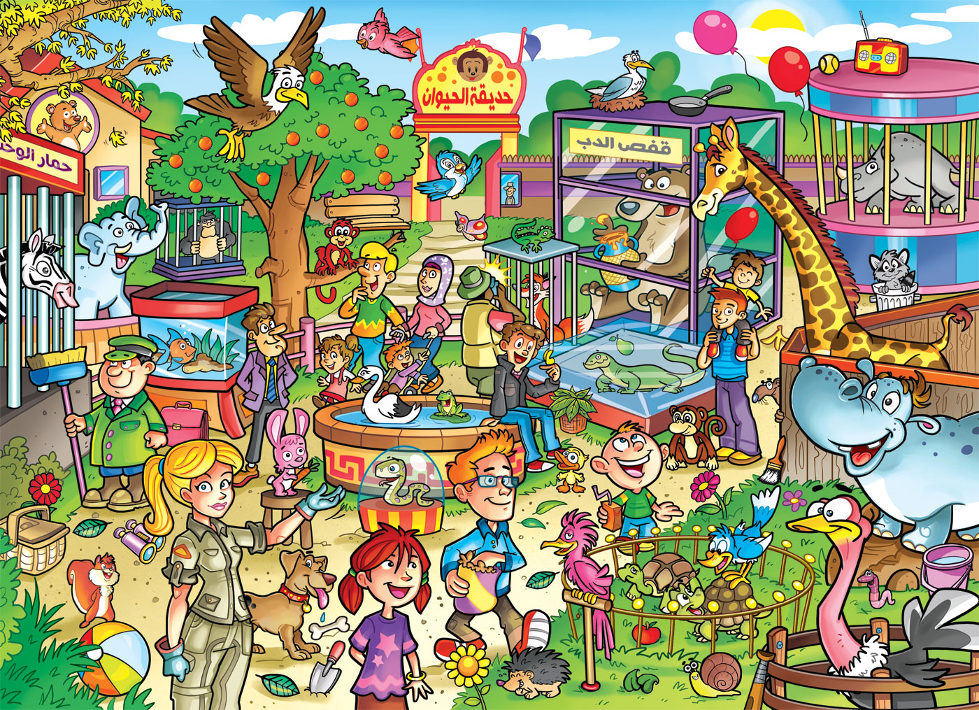
Concept Development
A who question has answers about people or animals.
A what question has answers about details or actions.
A when question has answers about time.
A where question has answers about a place.
A how question has answers a number or the way something is done.
CFU:
What is the purpose of a who question?
What is the purpose of a what question?
What is the purpose of a when question?
What is the purpose of a where question?
What is the purpose of a how question?
We can develop questions based on pictures.
Who… is holding the broom?
What… animals are in a cage?
When… did they leave the zoo?
Where… is the monkey?
How… did they hippo escape?
Notes:
crowded Zoo by samiatay on DeviantArt

Slide 7


Hinge Point Question
What sentences are questions?
When will we go to the playground?
When the rain stops, we will play outside?
What are we going to do?
What a terrible cake it was?
CFU:
Why is it/ isn’t it a an example of a question sentence?
A question sentence asks something where an answer is expected.
A question sentence ends with a question mark.
Question sentences often ask – who, what, when, where or how.
A who question has answers about people or animals.
A what question has answers about details or actions.
A when question has answers about time.
A where question has answers about a place.
A how question has answers a number or the way something is done.
Notes:
Hinge-point question:
Hinge-point questions are usually multiple choice questions that you ask your students when you reach the point in a lesson when you need to check if students are ready to move on, and if yes, in which direction. You can make it so there are multiple correct answers- this ensures there’s less chance of a ‘lucky guess’.
Go through each option one-at-a-time once students have answered on their whiteboards

Slide 8
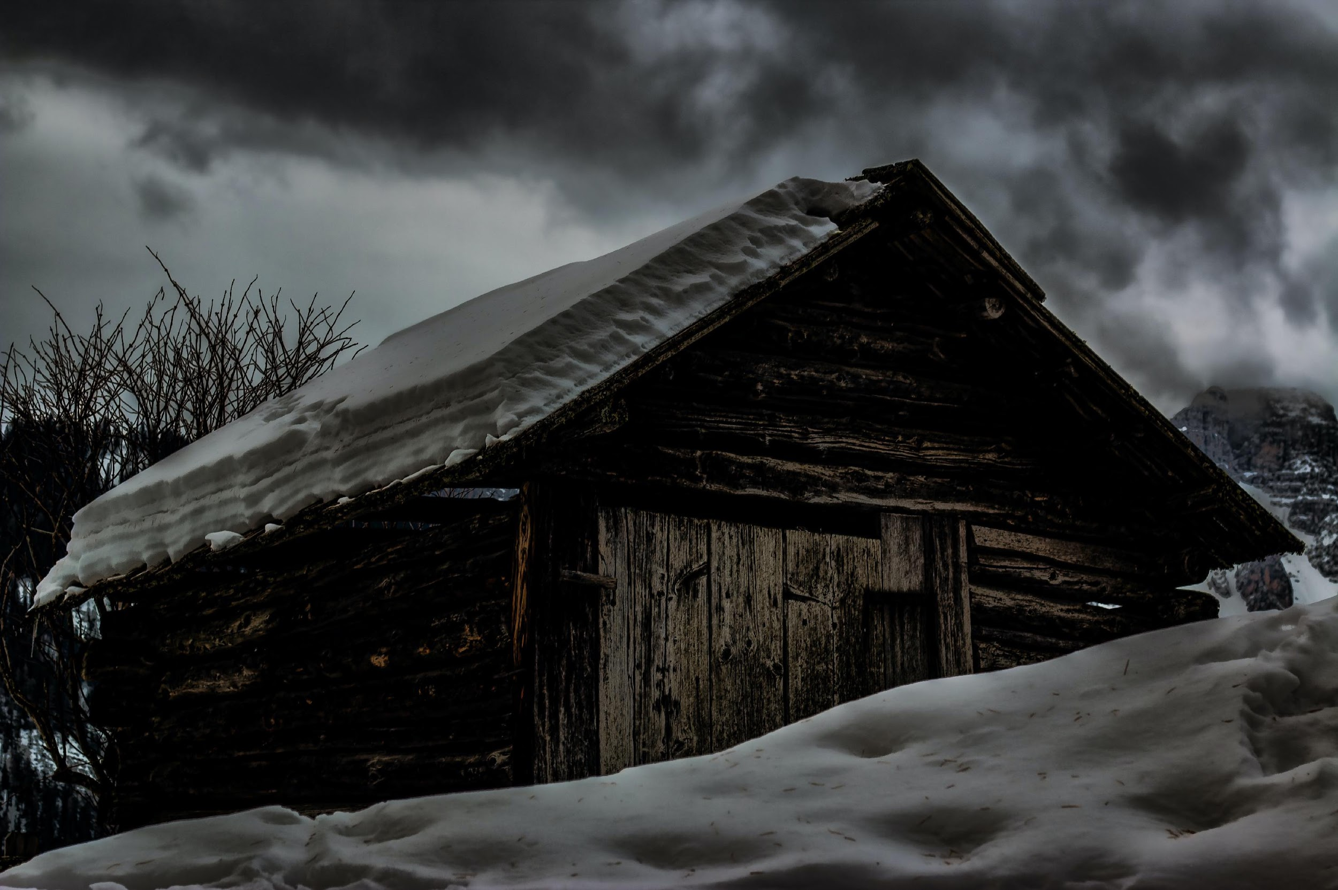
Concept Development-
re-explanation
A who question has answers about people or animals.
A what question has answers about details or actions.
A when question has answers about time.
A where question has answers about a place.
A how question has answers a number or the way something is done.
CFU:
What type of sentence is it?
How do you know?
What punctuation would you add?
Write a who, what, when, where, how question for this picture.
Who…
What…
When…
Where…
How…
does this cabin belong to?
is happening inside?
was this picture taken?
are the owners of the cabin?
do we get there?
Notes:
https://images.pexels.com/photos/746597/pexels-photo-746597.jpeg?cs=srgb&dl=cabin-covered-by-snow-746597.jpg&fm=jpg

Slide 9
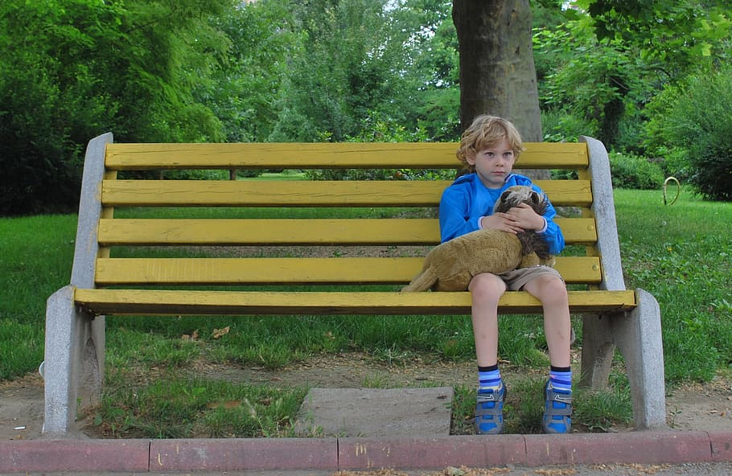
Skill development: I do
Think about the purpose of who, what, when, where and how questions.
Write a question based on the picture.
End each sentence with a question mark.
CFU:
How do you know it’s a statement /question/command/exclamation?
Who… (people or animals)
Who is the boy?
What… (details or actions)
What is he waiting for?
When… (time)
When did he get there?
Where… (place)
Where did he come from?
How… (number or the way something is done)
How old is he?
Notes:
https://p1.pxfuel.com/preview/970/84/914/boy-alone-sitting-bench.jpg

Slide 10
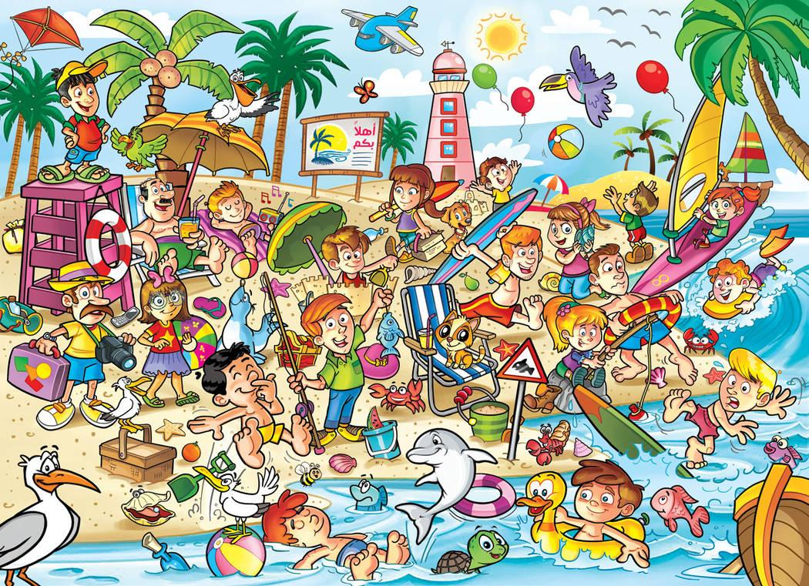

Skill development: We do
Think about the purpose of who, what, when, where and how questions.
Write a question based on the picture.
End each sentence with a question mark.
CFU:
How do you know it’s a question?
Who
A who question has answers about people or animals.
Notes:
Beach-crowd by samiatay on DeviantArt

Slide 11
Skill development: We do
Think about the purpose of who, what, when, where and how questions.
Write a question based on the picture.
End each sentence with a question mark.
CFU:
How do you know it’s a question?
What
A what question has answers about details or actions.
Notes:
Beach-crowd by samiatay on DeviantArt

Slide 12
Skill development: We do
Think about the purpose of who, what, when, where and how questions.
Write a question based on the picture.
End each sentence with a question mark.
CFU:
How do you know it’s a question?
When
A when question has answers about time.
Notes:
Beach-crowd by samiatay on DeviantArt

Slide 13
Skill development: We do
Think about the purpose of who, what, when, where and how questions.
Write a question based on the picture.
End each sentence with a question mark.
CFU:
How do you know it’s a question?
Where
A where question has answers about a place.
Notes:
Beach-crowd by samiatay on DeviantArt

Slide 14
Skill development: We do
Think about the purpose of who, what, when, where and how questions.
Write a question based on the picture.
End each sentence with a question mark.
CFU:
How do you know it’s a question?
How
A how question has answers a number or the way something is done.
Notes:
Beach-crowd by samiatay on DeviantArt

Slide 15

Skill development: You do
Think about the purpose of who, what, when, where and how questions.
Write a question based on the picture.
End each sentence with a question mark.
Write a who, what, when, where and how question for this picture in your book.
Who
What
When
Where
How
Notes:
Crowded Art by samiatay on DeviantArt

Slide 16
Other crowded scene pictures to use when reviewing this skill

Slide 17

Notes:
Camp-crowd by samiatay on DeviantArt

Slide 18
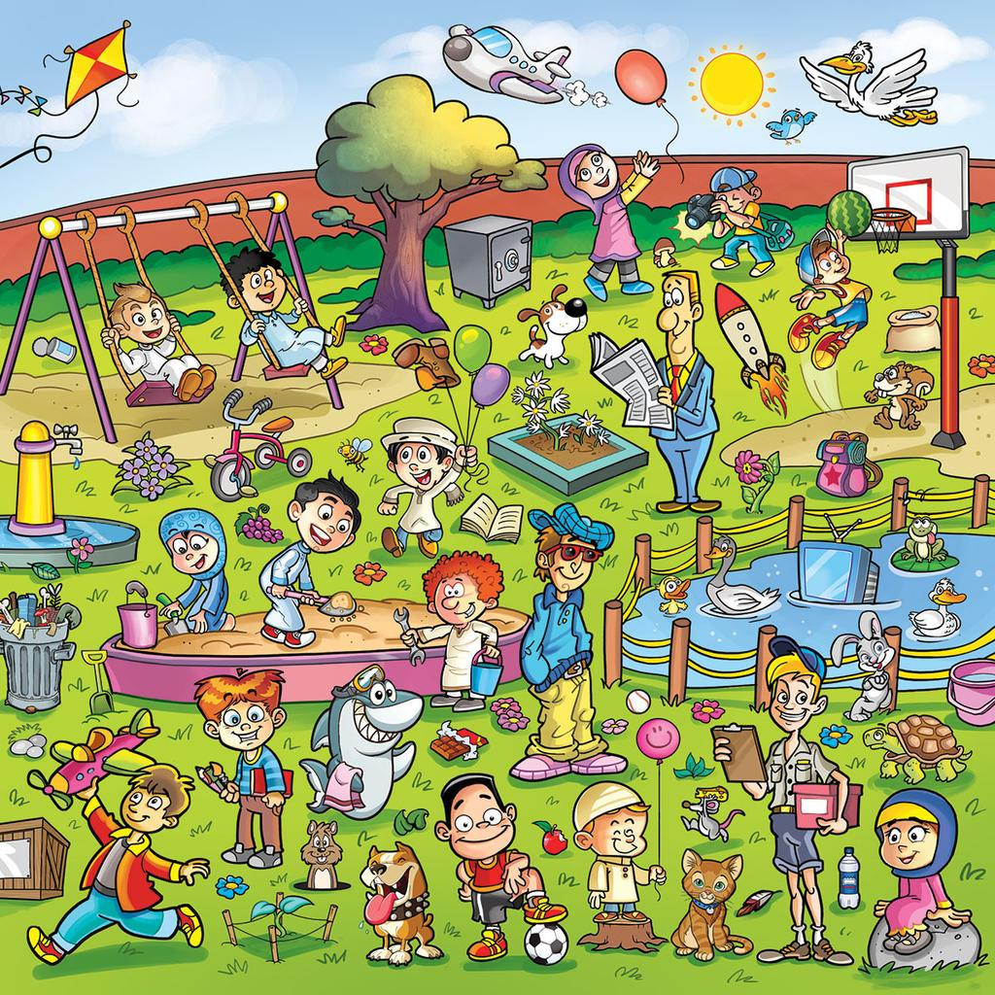
Notes:
park crowd by samiatay on DeviantArt

Slide 19

Notes:
crowded farm 2 by samiatay on DeviantArt

Slide 20
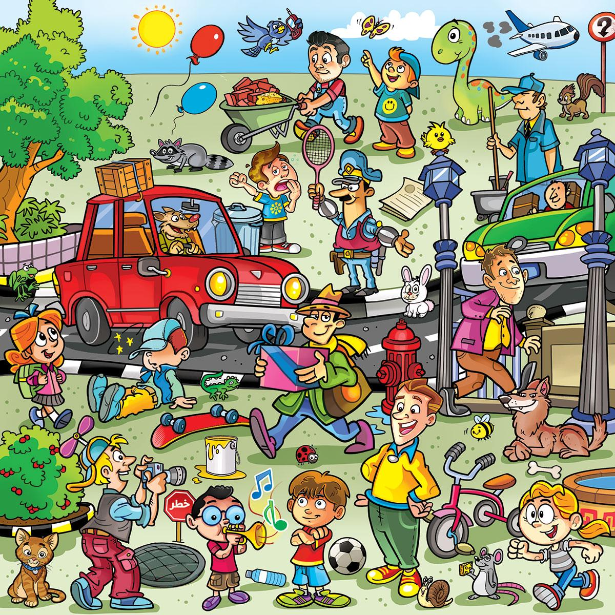
Notes:
City-crowd by samiatay on DeviantArt

